Slide 1
Chicago Area DNN Users Group
Thank you to our sponsors!
For providing web hosting for the CADUG Website & Pizza and Soda at our face-to-face meetings
They are offering any CADUG member a 50% discount on their first month of a new subscription

Slide 2
New nuke stuff
What’s happening in the world of #DNN
December 11th, 2013

Slide 3
Agenda
Social Media Update
Corporate Updates
Release Updates
Module Updates
DotNetNuke Products
CADUG Website Updates

Slide 4
How to get involved
Register at www.ChicagoDNN.org for news and announcements
Join the CAGUG Group on www.ChicagoDNN.com
Currently 227 users on the Website (up 15 from last report)
Join the CADUG Group on www.DnnSoftware.com
Currently 62 active members (down 1 from last report)
Join the LinkedIn Group on www.LinkedIn.com
Currently 57 active members (up 1 from last report)
Join the Facebook Group on www.Facebook.com/groups/cadug
Currently 28 active members (same as last report)
Follow us now on Twitter: @ChicagoDNN
Currently 178 people following (up 8 from last report)
Currently following 323 people (up 10 from last report)
Join the Meetup Group on meetup.com/ChicagoDNN
Currently 54 active members (up 1 from last report)
Join the CADUG Community on plus.google.com
Currently 42 active members (same as last report)

Slide 5
How to get involved
Can you please help us spread the word?
We are social, be sure that you have liked us, followed us, joined us, circled us, etc…
Share, like, retweet, +1 our posts and we will share, like and retweet and +1 your posts as well
Post a message about the Chicago Area DotNetNuke Users group to your Social Media circle of friends, family and neighbors
Tell people about us and help us grow this group

Slide 6
Dnn Corporate
Dnn In The News

Slide 7
Dnn Latest Press Releases
DNN Expands Product Suite, Services and SaaS Offering with ENN Evoq
July 9, 2013
New DNN Social Integrates Communities into Corporate Websites to Optimize Customer Engagement
March 19, 2013

Slide 8
Dnn in the News
DotNetNuke Changes Name, Conversations
Website Magazine
July 9, 2013
DotNetNuke Rebrands to DNN Evoq, Focuses and Business Solutions + Platform
CMS Wire
July 9, 2013

Slide 9
Dnn Corporate Blog
Web Content Management and E-Commerce that Doesn’t Break the Bank
Will Morgenweck 12/10/2013 0 Comments
Recently, Sitecore announced the acquisition of commerceserver.net, an e-commerce vendor and provider of the Commerce Server e-commerce engine. According to Sitecore, the acquisition “lays the foundation for the industry’s first .NET based, enterprise-grade Customer Experience Management (CXM) platform with a native, fully integrated e-commerce engine.” (source: Sitecore press release)

Slide 10
Dnn Corporate Blog
Evoq Content 7.2 and the Benefits of Digital Asset Management (DAM)
Israel Martinez 12/5/2013 0 Comments
DNN product manager Israel Martinez shares details on new Digital Asset Management (DAM) features in Evoq Content 7.2

Slide 11
Dnn Corporate Blog
Community Management Tips: Quotes from The Online Community Playbook
Dennis Shiao 11/26/2013 0 Comments
We share community management tips via quotes from The Online Community Playbook. Read the post for a link to download the playbook.

Slide 12
Dnn Corporate Blog
What Contagious (The Book) Teaches Us about the Growth of Starbucks
Navin V Nagiah 11/25/2013 0 Comments
Navin Nagiah recently read "Contagious: Why Things Catch On" by Jonah Berger. In this post, he draws lessons from the book to explain the success and growth of Starbucks.

Slide 13
Dnn Corporate Blog
What a Ride: Reflections on My First Year at DNN
Clint Patterson 11/21/2013 5 Comments
Clint Patterson gives you a look at DNN's culture by documenting his first year with the organization. Read further to understand why Clint feels he hasn't worked a day.

Slide 14
Dnn Corporate Blog
10 Steps to Building The Ultimate Online Community
Scott Albro 11/20/2013 0 Comments
Scott Albro provides a ten step plan to building the ultimate online community.

Slide 15
Dnn Corporate Blog
Improve Your SlideShare Marketing with These 10 Fun Facts
Dennis Shiao 11/15/2013 0 Comments
Read these ten fun facts about SlideShare, then apply them to become a more effective SlideShare marketer.

Slide 16
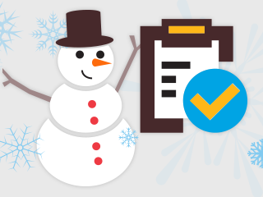
Dnn Webinar Events
The Only Holiday Checklist You Need (For Your Website)
Wednesday, Dec 11, 2013 09:00 AM - 09:30 AM PST (GMT -05:00) TODAY
Presenter(s): Dennis Shiao, Dir. Product Marketing, DNN Corp.
Skill Level: All
Target Audience: All
It is time to tally up the past year and look forward to 2014. Does your WCMS make it on the “good list”? Join us to receive a check list you can use for

Slide 17
Release Updates

Slide 18
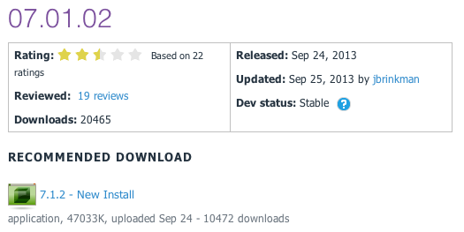
Release Updates
v07.01.02 Released
Prod: 09/24/13
16 Major Features
0 Security Fixes
0 Modules update
0 Providers update

Slide 19
Major Highlights
v07.01.02 Major Highlights
Added the ability to manage the Vanity URL prefix
Added the ability to filter members in the member directory by role
Fixed issue where the user could inadvertently click the login button multiple times
Fixed issues where core classes could not be used in out of process cache provider
Fixed issue where profile visibility submenu was not displayed correctly
Fixed issue where the member directory was broken when Convert URL to lowercase setting was enabled
Fixed issue where password checker didn’t work with unicode resource strings
Fixed issue where ExecuteDataSet had a breaking change in DNN 7.0
Fixed issue where Super User could not change personal profile URL
Fixed issue where installing site with blank template caused error
Fixed issue where upgrades failed when the ProfessionalPreview module is not installed
Fixed issue where social media auth providers are not properly filling in profile properties
Fixed issue where admin only content was not visible to Super User
Fixed issue where user gets an access denied error after password reset
Fixed issue where client resource manager failed to minify files
Fixed issue where search didn’t work after adding search results to alternate page

Slide 20
Security Fixes
Security Fixes
None
Modules
None
Providers
None

Slide 21
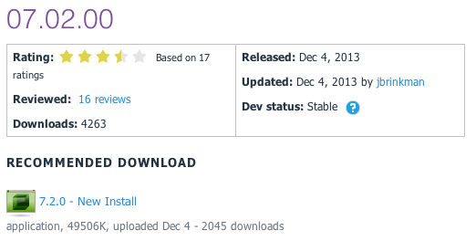
Release Updates
v07.02.00 Released
Prod: 12/04/13
6 Major Features
0 Security Fixes
0 Modules update
0 Providers update
7.2

Slide 22
Major Highlights
v07.02.00 What’s New
DNN 7.2.0 includes a number of new features and enhancements that will benefit users and developers alike along with a large number of bug fixes. Enhancements can be broadly broken down into two categories: 1) Application Features 2) Developer Features
Application Features
Responsive Design Skin
The Gravity skin was redesigned to use the Bootstrap framework which provides for a fully responsive design out of the box.
SQL Module
The SQL module has undergone a complete overhaul in 7.2.0 including a new editor and updated query results pane.
Module Creator
The DNN Module Creator has been incorporated directly into DNN making it easier than ever to get started writing your new DNN extension.
User Search
The DNN Search has been extended in 7.2.0 to include the ability to search users and user profiles (this feature is easily disabled for those who would prefer not to use it).
Developer Features
JavaScript Library Management
DNN 7.2.0 allows you to install JavaScript libraries as first party extensions. Once installed your module or skin can request that JavaScript library and the platform will automatically add the library into the page. The API mirrors the one used for jQuery and JQuery UI making it very easy to use.
Code Editor
The new CodeMirror code editor component has been added to DNN to provide a full syntax highlighting code editor when needed. Module developers can incorporate this feature with just a few lines of JavaScript.

Slide 23
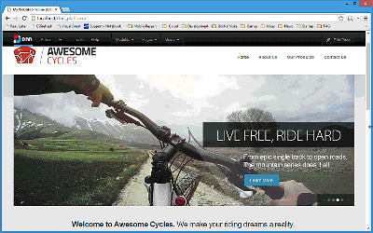
Application Features
RESPONSIVE DESIGN SKIN (COMMUNITY FEATURE)
The Gravity skin (and default website template) was redesigned to use the Bootstrap 2 framework. The new skin provides a fully responsive design out of the box which allows the skin to be used for a wide variety of device screen sizes. This skin provides a great example for other designers who are looking for examples of using Bootstrap or responsive design with DNN.
This feature enhancement was created by the awesome team at Arrow Designs. Special thanks to Ralph Williams and Henry Tavarez for their hard work on this enhancement.

Slide 24
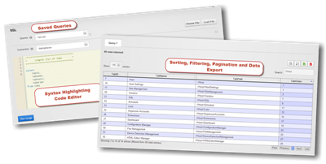
Application Features
SQL MODULE (COMMUNITY FEATURE)
The SQL module has undergone a complete overhaul in DNN 7.2.0. Supe rUsers now have the ability to save frequently used queries to aid in performing common database tasks. The module incorporates the CodeMirror code editor which provides syntax highlighting and other advanced editing features. In addition, the results grid was completely rewritten to provide sorting, pagination and data copy and data export capabilities.
This feature is still under development to add in some CSS styling to give it a clean, modern look in keeping with the rest of the admin UI. Even though it can still use a little love from our designers, please give this feature a good workout as all of the functionality is working.
This feature enhancement was contributed by longtime community members and DNN MVPs Vicenç Masanas and Peter Donker.

Slide 25
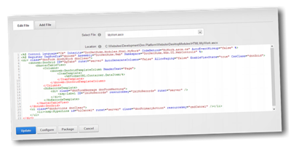
Application Features
MODULE CREATOR
The DNN Module Creator makes it easy to create and edit modules within your DNN installation. The module adds a syntax highlighting code editor, and easy to use predefined templates that make it simple to create custom extensions in just a few minutes.
This module was previously available on CodePlex but has been fully incorporated into DNN and enhanced with even better capability than before.

Slide 26
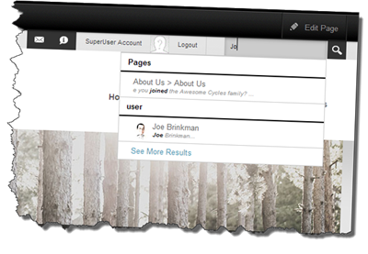
Application Features
USER SEARCH
DNN 7.1 introduced a completely overhauled search engine. DNN 7.2 enhances the search engine to include a new user search feature. Now you can easily search for users by their name or their user profile settings – just like the major social networks. As always, users are in complete control of how much or how little of their profile to make public.
With the Search Results module it is easy to determine exactly which types of search results will be displayed. If user search doesn’t make sense for your site then it is easily disabled.

Slide 27
Developer Features
DEVELOPER FEATURES
If you are a DNN developer we have a lot of feature enhancements in the beta to help make your life easier, and we have a few more that will be showing up after the beta so make sure you are keeping up with the Nightly Builds to see all the latest changes. As we get closer to release we’ll work on getting the developer documentation updated to show you how you can take advantage of these features in your development.
JAVASCRIPT LIBRARY MANAGEMENT
Module and skin developers often use third party JavaScript frameworks to simplify common client side development tasks. DNN 7.2 makes JavaScript libraries into a first class extension type for DNN. With this new API, developers have a common way of loading most JavaScript libraries. This allows modules to share libraries thus relieving developers from the task of re-distributing common libraries. DNN 7.2 will ship with a half dozen pre-installed libraries and more will be made available through the forge.
CODE EDITOR
DNN has a long history of providing users the ability to edit various application files. DNN 7.2 includes the CodeMirror code editor component to provide a full syntax highlighting code editing capability. Module developers can incorporate this capability into their own modules with just a few lines of JavaScript. With support for syntax highlighting, custom themes, tab completion, code folding and many more advanced features, you can create your own mini development experience that makes the most sense in your module. With support for over 70 languages and dozens of advanced features, I am sure you will find just what you need for your own development needs.

Slide 28
Module Updates

Slide 29
DNN Modules - Overview
DotNetNuke® Skins
Wed Sep 14, 2011
DotNetNuke® Announcements
Sun Jun 30, 2013
DNN Blog
Wed Dec 4, 2013
DotNetNuke® Documents
Fri Jun 7, 2013
DotNetNuke® Events
Tue Dec 3, 2013
DotNetNuke® FAQ
Thu Oct 10, 2013
DotNetNuke® Feedback
Fri Oct 4, 2013
DotNetNuke® Forum
Wed Jul 20, 2011
DotNetNuke® Gallery
Sun Jul 3, 2011
DotNetNuke® Iframe
Sun Jun 30, 2013
DotNetNuke® Links
Sun Jun 30, 2013
DotNetNuke® News Feeds
Thu Mar 28, 2013
DotNetNuke® Media
Wed May 22, 2013
DotNetNuke® Reports
Sun Jul 3, 2011
DotNetNuke® Repository
Thu Dec 22, 2011
DotNetNuke® Store
Sun Nov 18, 2012
DotNetNuke® Survey
Sun Jul 3, 2011
DNN® Form and List
Thu Oct 3, 2013
DotNetNuke® Users Online
Thu Jun 11, 2009
DotNetNuke® Wiki
Tue Nov 5, 2013
DotNetNuke® XML
Thu Sep 15, 2011
DotNetNuke® Auth: Active Directory
Thu Mar 14, 2013

Slide 30
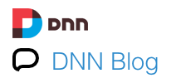
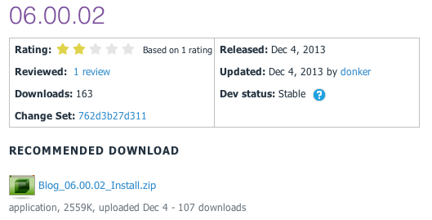
DNN Blog
v06.00.02 Released
Prod: 12/04/13

Slide 31
Release Notes
v06.00.02 Release
Fixes to v 6 migration script
Fix to ViewSettings token replace
Support for templates to be included in skin folder so they can be distributed with skins

Slide 32
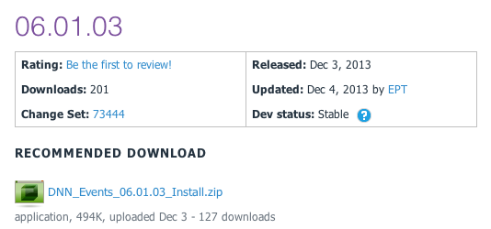
DNN Events
v06.01.03 Released
Prod: 12/03/13

Slide 33
Release Notes
DNN Events 06.01.03
Events 06.01.03 will work for any DNN version 6.2.7 and up. Full details on the changes can be found in great detail at the issues tab.
CHANGES
Updated EditEvents.ascx to work with DNN6/7 form patterns
Updated Events Module Settings to be serializable to enable support for Azure caching provider.
Added setting to enable admins to make User Profile events private.
BUG FIXES
Fixed reminder time validation in edit view
Corrected edit view validation, so that non-dynamic errors are displayed rather than page returning to non-edit view
Changed to handle all day events correctly in .ics files
Corrected handling of event notifications via sub-calendars
Fixed issues around display and editing of events in User Profile calendars
Fixed PubDate for negative timezones in RSS feed
Fixed bug in restricting categories
Adjusted padding around date/time pickers for DNN 7
Fixed bugs in sorting in List view
Fixed tooltip issue in Month view in DNN 7
NOTE
Although the minimum (technical level) DNN version is specified as 6.2.7, we strongly advise to start with DNN 7.2.0 if you use IE11, since the (Telerik based) date picker in DNN 6.2.7. is not correctly formatted in IE11. This is resolved in DNN 7.2.0 . NB Chrome and FireFox are not affected.

Slide 34
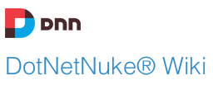
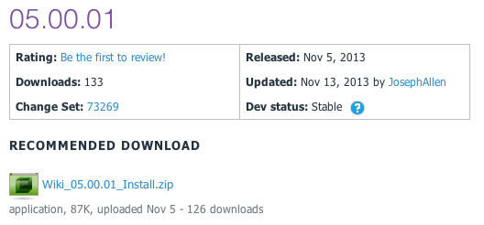
DNN Wiki
v05.00.01 Released
Prod: 11/05/13

Slide 35
Release Notes
Enhancements:
Journal Integration
Added "Delete Confirmation"
"Add Page" button to "All Pages View"
Big Fixes
Pressing Enter on Wiki Search Page Displays Search Results
RSS Feeds display correctly

Slide 36
CADUG Updates
Website & Social Media Websites

Slide 37
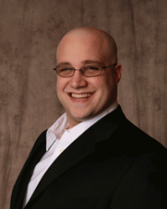
CADUG Website Hosting
The Chicago Area DotNetNuke Website Hosting is provided by:
Be sure to stop by and check out our sponsors for the best in DotNetNuke hosting
Sprocket Websites uses and recommends PowerDNN to its customers
Tony Valenti, CEO of PowerDNN

Slide 38
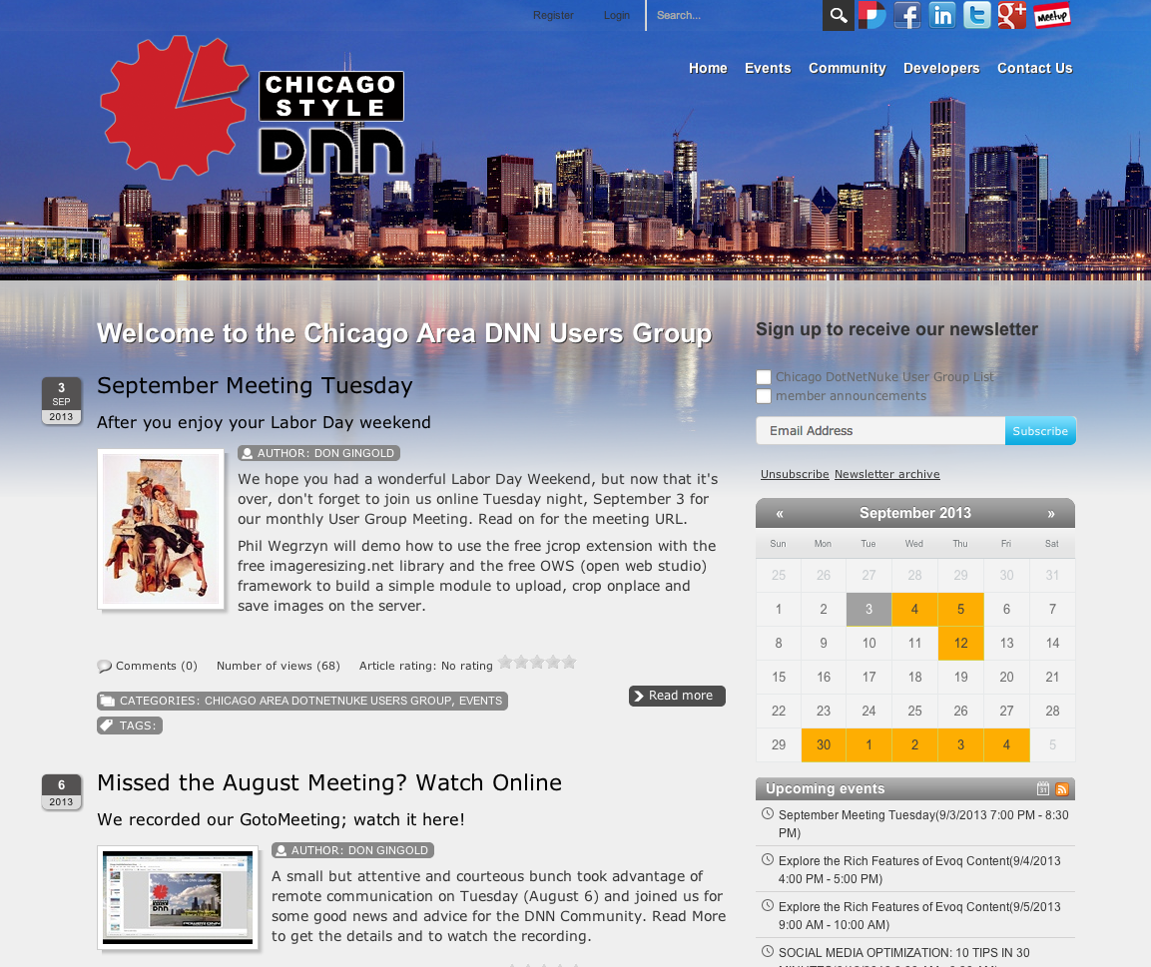
CADUG Website

Slide 39
Want to contribute to the Chicago Area DotNetNuke Website?
Ask Me How…

Slide 40
Wrap Up / Q&A
Important Links
Thank You
ChicagoDNN.org
meetup.com/ChicagoDNN
twitter.com/ChicagoDNN
DotNetNuke.com
store.DotNetNuke.com
PowerDNN.com
James Nagy
Sprocket Websites, Inc.
Jim@SprocketWebsites.com
www.SprocketWebsites.com
@SprocketWebsite
630.344.9320

