Slide 1
Chicago Area DNN Users Group
Thank you to our sponsors!
For providing web hosting for the CADUG Website & Pizza and Soda at our face-to-face meetings
They are offering any CADUG member a 50% discount on their first month of a new subscription

Slide 2
New nuke stuff
What’s happening in the world of #DNN
October 8th, 2014 – Happy Halloween

Slide 3
Agenda
Social Media Update
Corporate Updates
Release Updates
Module Updates
DotNetNuke Products
CADUG Website Updates

Slide 4
How to get involved
Register at www.ChicagoDNN.org for news and announcements
Join the CAGUG Group on www.ChicagoDNN.com
Currently 198 members on the Website (registration is turned off)
Join the LinkedIn Group on www.LinkedIn.com
Currently 63 active members (up 2 from last report)
Join the Facebook Group on www.Facebook.com/groups/cadug
Currently 37 active members (up 1 from last report)
Follow us now on Twitter: @ChicagoDNN
Currently 304 people following (up 3 from last report)
Currently following 901 people (up 7 from last report)
Join the CADUG Community on plus.google.com
Currently 48 active members (down 1 from last report)

Slide 5
How to get involved
Can you please help us spread the word?
We are social, be sure that you have liked us, followed us, joined us, circled us, etc…
Share, like, retweet, +1 our posts and we will share, like and retweet and +1 your posts as well
Post a message about the Chicago Area DotNetNuke Users group to your Social Media circle of friends, family and neighbors
Tell people about us and help us grow this group

Slide 6
Dnn Corporate
Dnn In The News

Slide 7
Dnn In The News Articles
Last Post
6/21/2014
How Brands Could Destroy Native Advertising

Slide 8
Dnn Latest Press Releases
Last Post
5/5/2014
New Study Finds Marketers Drowning in Sea of Vendors, Technologies and Complexity

Slide 9
Dnn Corporate Blog
32 Tips to Rock Your Online Sales Demos
Clint Patterson, DNN's Sales Engineering Manager, provides 32 tips for rocking your next online sales demo.
Posted on 10/6/2014 by Clinton Patterson

Slide 10
Dnn Corporate Blog
Why We All Love Online Support Communities
Support managers, current customers, prospects and brands. They all love branded, online support communities. Read the full post to learn why.
Posted on 9/30/2014 by Julie Neidlinger

Slide 11
Dnn Corporate Blog
How Data Can Be a Competitive Weapon in Your Content Marketing
It seems that everyone is doing content marketing today. So how do you create content that stands out from the crowd? One word: data.
Posted on 9/22/2014 by Dennis Shiao

Slide 12
Dnn Webinar Events
Building Your Business Case for a Branded Online Community
Thursday, Oct 16, 2014 09:00 AM - 10:00 AM PDT (GMT -04:00)
Presenter(s): Vanessa DiMauro, Founder/CEO Leader Networks & Dennis Shiao, Director of Content Marketing DNN
Skill Level: all

Slide 13
Release Updates

Slide 14
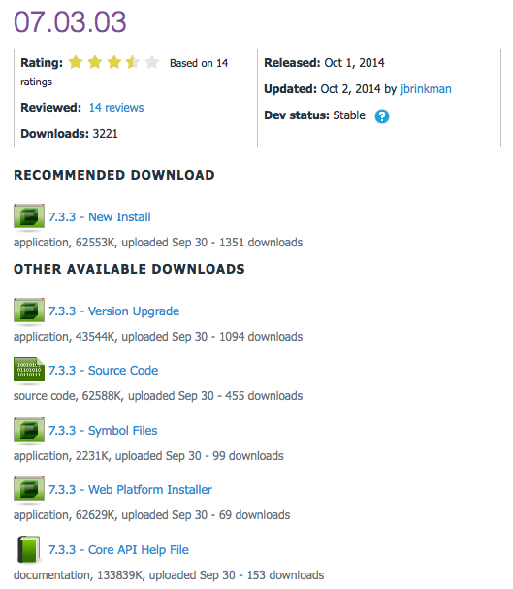
Release Updates
v07.03.03 latest release
Prod: 10/01/14
16 Major Features
1 Security Fixes
0 Modules update
0 Providers update
7.3

Slide 15
Major Highlights
v07.03.03 Major Highlights
Enhanced DDR Menu to allow menus to be filtered by page tags
Enhanced messaging system to support additional tokens
Enhanced core library to include extension methods for creating/manipulating XML documents
Fixed issue where notifications were not updated without a page refresh
Fixed issue where site management was not working correctly with site skins
Fixed issue where upgrades can fail due to a versioning issue
Fixed issue where foldermanager was inefficient in iterating child folders and files in a given folder
Fixed issues where RadEditor provider did not work correctly in IE11
Fixed issue where custom page URLs were not properly formatted
Fixed issue where page settings were not properly saved for localized pages
Fixed issue where sample Razor script would list all users in an installation
Fixed issue where improper module manifest can break extensions page
Fixed issue where social modules did not update search index appropriately
Fixed issue where malformed profile urls or profile pages for deleted users caused error in event log
Fixed issue where upgrades failed for case sensitive SQL collations
Fixed issue where reordering tabs in one portal affected tab order in other portals

Slide 16
Security Fixes
Security Fixes
Failure to validate user messaging permissions
Modules
None
Providers
None

Slide 17
Community Members
Thanks to the following community members who submitted fixes and enhancements for this release.
Peter Donker – Added localized list support
Vicenc Masanas – Fixed issues in user profile, scheduler, page ordering and user account settings
Lucas Jans – Added tag filter to DDRMenu and fixed threadabort errors on redirect
Sebastian Leupold – Fixed issue with SQL scripts and typos in resource file
Jan Jonas – Fixed issue with invalid profile urls, rolecontroller caching issue, and malformed module manifests
Oliver Hine – Fixed multiple performance issues
Brian Dukes - Enhanced collectionextension methods to support null types
Evan Smith - Fixed issue in sample Razor script
I want to give a special mention to Torsten Weggen who we missed on the 7.3.2 release notes. Torsten added an enhancement in 7.3.2 to allow admins to select alternate icon set

Slide 18
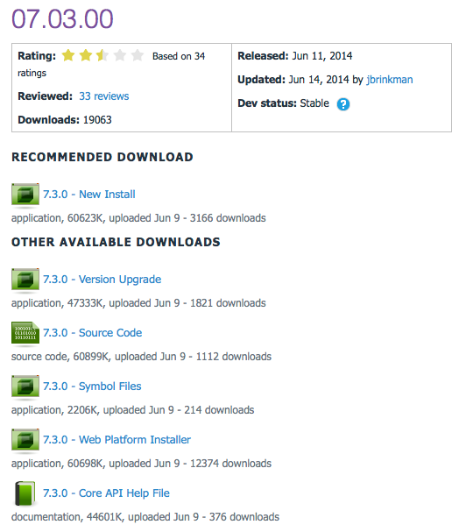
Release Updates
v07.03.00 latest release
Prod: 06/26/14
7 Major Features
0 Security Fixes
0 Modules update
0 Providers update
7.3

Slide 19
Major Highlights
v07.03.00 Major Highlights
The theme for DNN 7.3 is performance. The entire platform has been optimized from a variety of perspectives to improve overall system performance.
Page markup reduction - intelligent resource management
Removal of unnecessary Viewstate – Home page 4005 bytes down to 90 bytes
YSlow base score improvement (7.2.2 80/Grade C -> 7.3.0 93/Grade A)
25% reduction in Page size for Home page requests.
Extra caching and streamlining of database calls
Reduce database activity in high transaction scenarios
Granular management of objects in cache to reduce cache rebuilds
New 51 Degrees implementation
New lookup algorithm 100x faster
Zero memory consumption
Can be disabled if required
Admin UI Updates for increased Admin page load speed
File picker/upload control updated for drag/drop
Permissions Grid optimized for active roles only
Add Module Control bar improvements
Bookmarking for favorite Modules
Search feature for finding modules
Lazy load feature to speed panel load
Improved scrolling
Scheduled Tasks Improvement
More granular control over jobs including ability to set a start date/time
Delayed initialization for faster application startup
Folder Provider Improvements
Ability to create new sites with the site root Folder on remote storage – separating user data from application data.

Slide 20
Security Fixes
Security Fixes
None
Modules
None
Providers
None

Slide 21
Community Members
The complete set of Release Notes for DNN 7.3 is available at:
https://dnntracker.atlassian.net/secure/ReleaseNote.jspa?projectId=10212&version=11902.
You can find more information about community contributions to DNN 7.3 at:
http://www.dnnsoftware.com/community-blog/cid/154993/community-makes-huge-impact-on-dnn-73.

Slide 22
Module Updates

Slide 23
DNN Modules - Overview
DotNetNuke® Skins
Wed Sep 14, 2011
DotNetNuke® Announcements
Sun Jun 30, 2013
DNN Blog
Mon Sep 29, 2014
DotNetNuke® Documents
Fri Aug 26, 2014
DotNetNuke® Events
Fri Oct 3, 2014
DotNetNuke® FAQ
Wed Feb 12, 2014
DotNetNuke® Feedback
Fri Oct 4, 2013
DotNetNuke® Forum
Wed Jul 20, 2011
DotNetNuke® Gallery
Sun Jul 3, 2011
DotNetNuke® Iframe
Sun Jun 30, 2013
DotNetNuke® Links
Fri Mar 7, 2014
DotNetNuke® News Feeds
Thu Mar 28, 2013
DotNetNuke® Media
Sun Feb 9, 2014
DotNetNuke® Reports
Mon Feb 10, 2014
DotNetNuke® Repository
Thu Dec 22, 2011
DotNetNuke® Store
Sun Nov 18, 2012
DotNetNuke® Survey
Sun Jul 3, 2011
DNN® Form and List
Thu Apr 17, 2014
DotNetNuke® Users Online
Thu Jun 11, 2009
DotNetNuke® Wiki
Tue Nov 5, 2013
DotNetNuke® XML
Thu Sep 15, 2011
DotNetNuke® Auth: Active Directory
Thu Mar 14, 2013

Slide 24
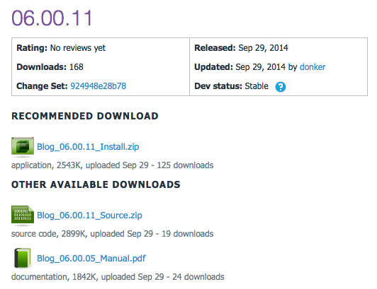
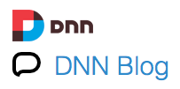
DNN Blog
v06.00.11 Released
Prod: 06/04/14

Slide 25
Release Notes
v06.00.11
Fix: Fix To Classic Blog Template (23990)
Fix: HTML encode item description in XML feed rather than strip HTML (24021)
Fix: Fix to TabCloud filtering to one blog post (24097)
Fix: Fix issue with module view settings

Slide 26
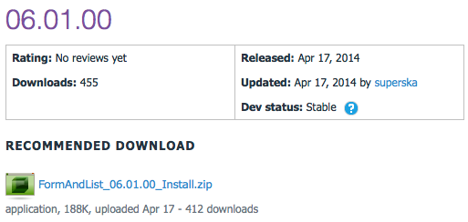
DNN Form and List
v06.01.00 Released
Prod: 04/17/14

Slide 27
Release Notes
v06.01.00
Fix for DNN 7.2.2
Allowed for custom datatypes.config (to be placed in Portals/_default/UserDefinedTable).
datatypes.config in the DesktopModules/UserDefinedTable will remain to be overwriten on installation of a new version. However, if you copy it to the folder mentioned above, your cusotmizations will not be overwriten on installation anymore.

Slide 28
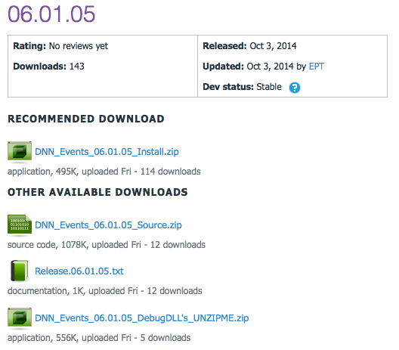
DNN Events
v06.01.05 Released
Prod: 10/03/14

Slide 29
Release Notes
v06.01.05 Release
BUG FIXES
Fixed loading JS library for the scheduler control
CHANGES
Upgraded to .NET 4.0 framework to support DNN 7.2

Slide 30
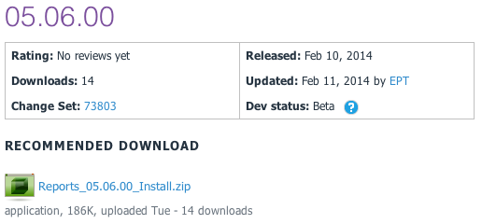
DNN Reports
v05.06.00 Released
Prod: 02/10/14

Slide 31
Release Notes
v05.06.00 Release
Release to make DNN Reports work for DNN 7.0.0 and up
BUG FIXES
Fixed xslt visualizer xsl file retrieval
Fixed HTML visualizer html file retrieval
ENHANCEMENTS
Made the dataprovider scripts SQL Azure compliant

Slide 32
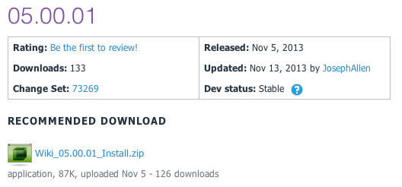
DNN Wiki
v05.00.01 Released
Prod: 11/05/13

Slide 33
Release Notes
Enhancements:
Journal Integration
Added "Delete Confirmation"
"Add Page" button to "All Pages View"
Big Fixes
Pressing Enter on Wiki Search Page Displays Search Results
RSS Feeds display correctly

Slide 34
CADUG Updates
Website & Social Media Websites

Slide 35
CADUG Website Hosting
The Chicago Area DotNetNuke Website Hosting is provided by:
Be sure to stop by and check out our sponsors for the best in DotNetNuke hosting
Sprocket Websites uses and recommends Managed.com to its customers
Tony Valenti, CEO of Managed.com

Slide 36
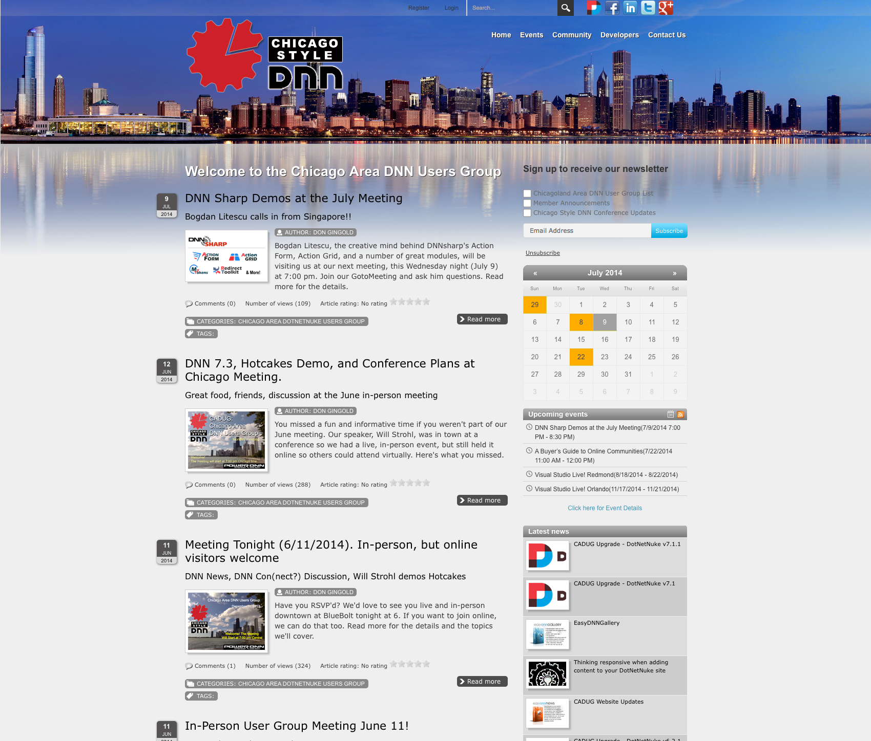
CADUG Website

Slide 37
Want to contribute to the Chicago Area DotNetNuke Website?
Ask Me How…

Slide 38
Wrap Up / Q&A
Important Links
Thank You
ChicagoDNN.org
DnnSoftware.com
store.DnnSoftware.com
Managed.com
James Nagy
Sprocket Websites, Inc.
Jim@SprocketWebsites.com
www.SprocketWebsites.com
@SprocketWebsite
630.344.9320

