Slide 1
Chicago Area DNN Users Group
Thank you to our sponsors!
For providing web hosting for the CADUG Website & Pizza and Soda at our face-to-face meetings
They are offering any CADUG member a 50% discount on their first month of a new subscription

Slide 2
New nuke stuff
What’s happening in the world of DotNetNuke
August 6th, 2013

Slide 3
Agenda
Social Media Update
Corporate Updates
Release Updates
Module Updates
DotNetNuke Products
CADUG Website Updates

Slide 4
How to get involved
Register at www.ChicagoDNN.org for news and announcements
Join the CAGUG Group on www.ChicagoDNN.com
Currently 209 users on the Website (up 6 from last report)
Join the CADUG Group on www.DotNetNuke.com
Currently 56 active members (up 3 from last report)
Join the LinkedIn Group on www.LinkedIn.com
Currently 53 active members (down 1 from last report)
Join the Facebook Group on www.Facebook.com/groups/cadug
Currently 29 active members (same as last report)
Follow us now on Twitter: @ChicagoDNN
Currently 151 people following (up 14 from last report)
Currently following 294 people (up 63 from last report)
Join the Meetup Group on meetup.com/ChicagoDNN
Currently 51 active members (up 3 from last report)
Join the CADUG Community on plus.google.com
Currently 41 active members (down 1 from last report)

Slide 5
How to get involved
Can you please help us spread the word?
We are social, be sure that you have liked us, followed us, joined us, circled us, etc…
Share, like, retweet, +1 our posts and we will share, like and retweet and +1 your posts as well
Post a message about the Chicago Area DotNetNuke Users group to your Social Media circle of friends, family and neighbors
Tell people about us and help us grow this group

Slide 6
DotNetNuke Corporate
In The News

Slide 7
DotNetNuke in the News
DotNetNuke Changes Name, Conversations
What’s in a name? For DNN (formerly DotNetNuke) it’s the difference between speaking to the .NET developer, which they have primarily done in the past, or talking to company leaders about the business problems they have and how DNN is able to solve them, which they are doing today.
DNN, primarily known as a CMS company and one that is mainly leveraged by those using .Net framework, has undergone a complete rebranding in both its business name and its portfolio to become an end-to-end content and social community provider. Today, DNN has made available new tools and more capabilities that will be available for non-.NET users.

Slide 8
DotNetNuke in the News
DNN EXPANDS PRODUCT SUITE, SERVICES AND SAAS OFFERING WITH DNN EVOQ
New DNN Suite offers unmatched online content and community management, available in the cloud via Windows Azure
San Mateo, Calif., July 9, 2013 – DNN (formerly DotNetNuke), whose award-winning web content management system (CMS) powers hundreds of thousands of websites around the world, today announced DNN Evoq, a suite of integrated applications enabling enterprises to create immersive online experiences and powerful interactive communities. DNN Evoq makes it easy for users, including those with minimal IT experience, to integrate social functionality with their existing websites.

Slide 9
DotNetNuke in the News
DNN Evoq currently includes the following applications:
Evoq Content – A business solution that helps bring corporate websites to life. Evoq Content empowers both technical and business users to create, manage and update rich, immersive online experiences. The solution is equipped with top-notch security, e-commerce, extensibility and support features – across Web- and mobile-based sites, seamlessly.
Evoq Social – The only enterprise-class solution that incorporates a broad range of best-in-class social community capabilities including: true extensibility, an intuitive and consistent Management UI, and the best price/value alternative. Evoq Social gives users the ability to seamlessly integrate communities into corporate websites, instead of driving customers to a third-party social site, which enables them to monitor and shape the customer conversation. Thriving user communities can help reduce support costs, drive product innovation and increase sales and brand awareness at an affordable price point.

Slide 10
DotNetNuke Events
Explore the Rich Features of Evoq Content
Wednesday, Aug 07, 2013 09:00 AM - 10:00 AM PDT (GMT -04:00)
Presenter(s): Michael Doxsey, Sales Engineer and Trainer, DNN Corp.
Skill Level: Beginner
Target Audience: Business Decision Makers, Content Owners, Marketers
Evoq Content allows your organization to exceed expectations by making it possible to build a

Slide 11
DotNetNuke Events
Explore Evoq Social!
Wednesday, Aug 14, 2013 09:00 AM - 10:00 AM PDT (GMT -04:00)
Presenter(s): Clint Patterson, Sales Engineer and Trainer, DNN Corp.
Skill Level: All
Target Audience: Business Decision Maker, Marketing Personnel, Content Owner, Community Manager
Learn how, with Evoq Social, you can own the conversation, on your site, and turn visitors into

Slide 12
DotNetNuke Events
6 Benefits for Hosting Your Website in the Cloud
Wednesday, Aug 28, 2013 09:00 AM - 10:00 AM PDT (GMT -04:00)
Presenter(s): Dennis Shiao, Director Product Marketing, DNN Corp.
Skill Level: All
Target Audience: Business Decision Makers, Marketers
Even though it’s the middle of summer, we think the future of the web is “cloudy” (pun intended).

Slide 13
Release Updates

Slide 14
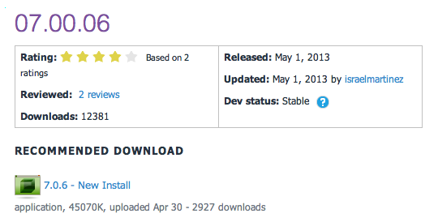
Release Updates
v07.00.06 Released
Prod: 04/03/13
24 Major Updates
0 Security Fixes
5 Modules update
0 Providers update

Slide 15
Major Highlights
v07.00.06 Major Highlights
Fixed issue that caused broken links when changing the name of a page
Added search capabilities in the page management section
Added new functionality to the Member Directory so that users can choose between the different search options
When creating a social group the newly created role group is now set as the default group
Implemented new functionality to allow users to hid the login button in the default skin
Removed the module and skin templates from the Starter Kit package
Fixed issue that shows an error when registration is set to unique display name
Fixed issue that made child site files not to show when managing sites
Fixed UX issue when changing the file size in the configuration management section
Fixed issue in the Journal module where followers could see posts that are meant for friends only
Fixed paging conflict between roles and users in the users' accounts screen
Added new functionality that allows users to see all the social groups they belong to
Fixed issue where separating a site from a group would not copy all the users
Fixed issue when creating a page from a template when the template has modules that are set to display on all pages
Removed the "-" from the invalid character list for page names
Fixed the styling in the date time picker to display the time
Fixed issue that shown the tokens when searching for pages
Fixed issue that made the site redirection management screen to not work correctly when pop ups are disabled
Fixed issue where exported templates point to the incorrect site settings
Fixed issue that caused Social Group Roles to be limited to the Global Role group
Fixed issue when page names include a ":" colon
Fixed issue where scheduler runs overlap when retry is set to a short interval
Fixed issue with modules that are expected to display in all pages and Content Localization is enabled.
Implemented auto-refresh functionality in the message center so that users can see updates in real time without refreshing the page

Slide 16
Security Fixes
Security Fixes
None
Modules
Device Preview Management Module
Pages Module
Journal Module
Member Directory Module
Site Groups Module
Providers
None

Slide 17
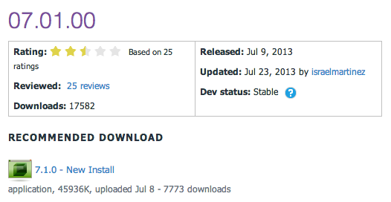
Release Updates
v07.01.00 Released
Prod: 07/09/13
11 Major Features
0 Security Fixes
7 Modules update
0 Providers update

Slide 18
Major Highlights
v07.01.00 Major Highlights
Implemented functionality so that users are able to assign custom CSS to pages without modifying the skin
Updated to JQuery 1.9.1
Implemented auto-complete functionality in the taxonomy module
Updated the page and user selector controls to improve the experience in larger sites with multiple users
Implemented a warning message for Azure users when they install a module that does not have the Azure Compatible flag
Fixed issue where users were being logged out if switching between www.domain.com and domain.com
Fixed issue when exporting and importing a template where content localization is enabled
Fixed issue where data was not being cleaned up after removing a folder provider
Fixed issue that made modules not to render correctly when module caching was enabled through the Client Resource Management Framework
Added support for accents in profile properties
Fixed issue where calling the GetUserByVanityUrl function was throwing an error

Slide 19
Security Fixes
Security Fixes
None
Modules
File Manager
Languages Module
Pages Module
Taxonomy Module
Journal Module
Membler Directory Module
Social Groups
Providers
None

Slide 20
Major Highlights
v07.01.00
I’m pleased to announce that we have just released a Community Technology Preview of DotNetNuke 7.1. Consider this an early Beta that is intended to give you a sneak preview of some of the features that will be available in the final release. Just to be clear, this is not a production quality release and only intended to be used for testing and evaluation purposes. The CTP release will allow us to collect valuable feedback on key functionality early in the release cycle so that we can incorporate your feedback into the final release. Please take a few minutes to learn about some of the key items in the DotNetNuke 7.1 CTP.

Slide 21
New Features
Password Management
DotNetNuke now offers additional capabilities to ensure that your site is as secure as possible. Passwords are now recovered through a password reset link. This means that passwords are never emailed in plain text. The password strength meter will help ensure your users are following best practices for creating secure passwords. The Banned Passwords List provides you with a way to make sure your users aren’t using some of the most common passwords that easy to guess. We have also added an option for retaining password history. This allows you make sure that users change their passwords appropriately to match your password policy.

Slide 22
New Features

Slide 23
New Features
Improved URLs
The first thing you should notice in DotNetNuke 7.1 is that we have improved the URLs. By default for new installs you will notice that we have removed the “.aspx” extension. Vanity profile URLs are now included in the platform as well. Users will be able to define their own vanity URL under the account management area. We have more enhancements coming for URL management that will be available in the next Beta. Bruce Chapman will be sharing everything you need to know in the coming weeks.

Slide 24
New Features

Slide 25
New Features
File Management
DotNetNuke’s file manager is a module designed to provide a user interface to a website’s file system. The most common operations performed by users on file and folders are: create, open, edit, view, print, play, move, copy, delete and search. Many users also need the ability to modify file attributes, properties, and permissions. A few highlights for this release include:
User Interface - The user interface has been completely overhauled to match the patterns in the DotNetNuke WCMS. The new file manager now follows the new look and feel, incorporates new controls and it also includes a new icon view.
User Experience - The way a user interacts with the application has been completely redefined. Users will find the new file manager more intuitive and user friendly. We have also added features that users have come to expect such as drag and drop uploads, zip downloads, and file URLs.
Performance - The overall performance has been improved which will deliver substantial improvements for organizations with large numbers of files and folders.

Slide 26
New Features

Slide 27
New Features
Search Redesigned
Search has been completely redesigned within DotNetNuke. All I can really say is that you are going to be impressed! With features like auto suggest, advanced filters, nearly instant content indexing and tag filters, you are sure to be excited about the new search capabilities in DotNetNuke 7.1. Our Development Manager, Ash Prasad, will have a more detailed blog about search very shortly. Download the CTP and test out the search features today!

Slide 28
New Features

Slide 29
CTP / Beta v7.1 DNN
What to expect in the CTP?
Just a reminder, this is not a production ready release. This isn’t close to the quality we would expect for a Beta release. We want to give everyone a preview of what we have been working on and get as much feedback as possible. You will find bugs. You will run into features that aren’t complete or that don’t work at all. You will definitely run into features that are still a work in progress. We ask that you pay close attention to the items I listed above and provide us with your feedback.

Slide 30
CTP / Beta v7.1 DNN
What If I Find a Problem?
If you happen to have issues with the CTP, the first thing you should do is check the known issues list in the DotNetNuke Beta Forum. We will do our best to keep this list as accurate as possible. If you have found a bug that you can reproduce, we ask that you please create the bug report in our Bug Tracker. If you have questions about functionality or how to do something, please post your question in the Community Exchange. For all other feedback and discussions please use the Open Core Testing Forum. If you aren’t sure which one to use, just use what is most convenient for you. We’ll be looking for feedback everywhere!

Slide 31
CADUG Updates
Website & Social Media Websites

Slide 32
CADUG Website Hosting
The Chicago Area DotNetNuke Website Hosting is provided by:
Be sure to stop by and check out our sponsors for the best in DotNetNuke hosting
Sprocket Websites uses and recommends PowerDNN to its customers
Tony Valenti, CEO of PowerDNN

Slide 33
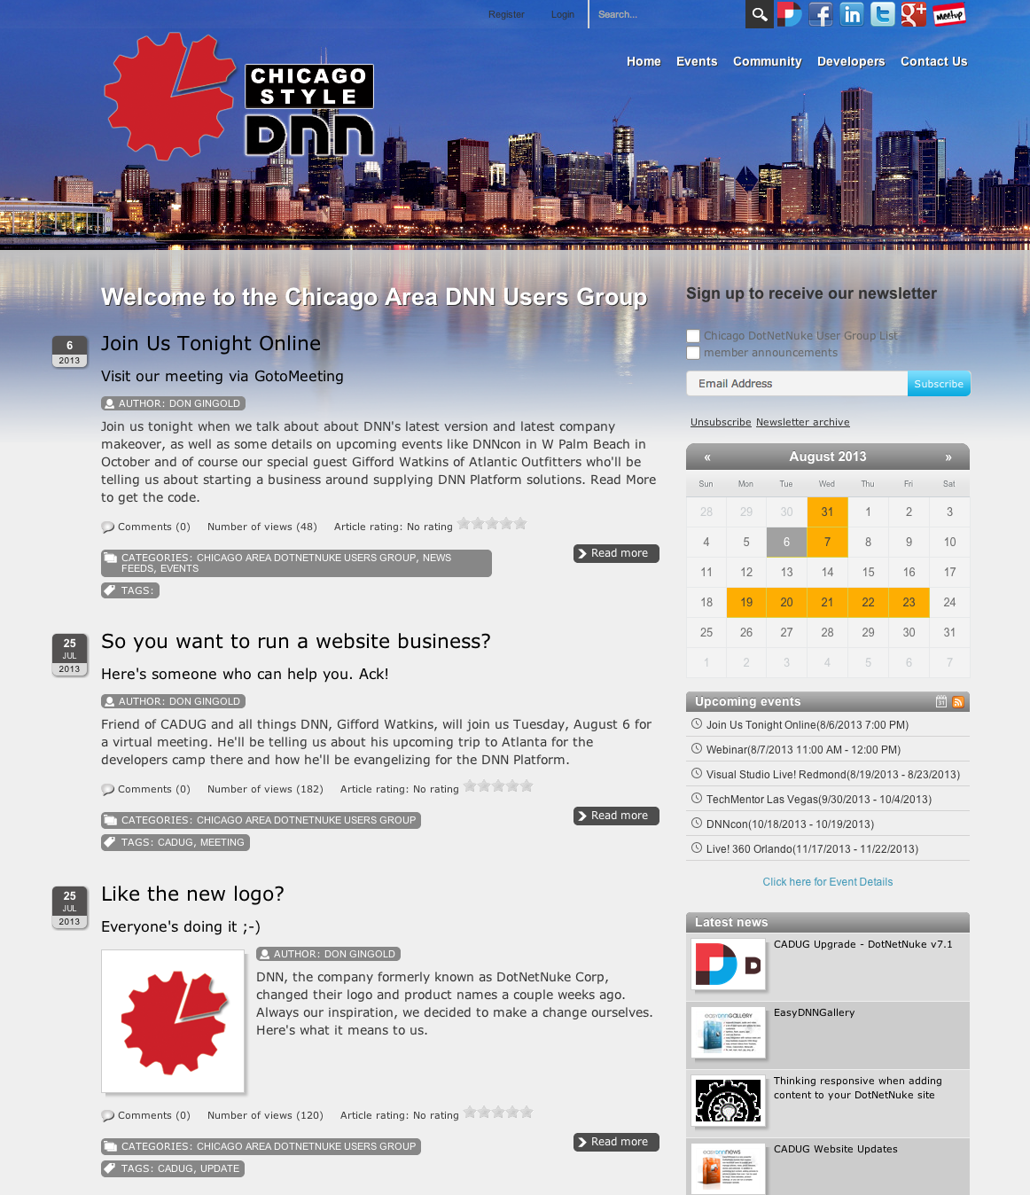
CADUG Website

Slide 34
Want to contribute to the Chicago Area DotNetNuke Website?
Ask Me How…

Slide 35
Wrap Up / Q&A
Important Links
Thank You
ChicagoDNN.org
meetup.com/ChicagoDNN
twitter.com/ChicagoDNN
DotNetNuke.com
store.DotNetNuke.com
PowerDNN.com
James Nagy
Sprocket Websites, Inc.
Jim@SprocketWebsites.com
www.SprocketWebsites.com
@SprocketWebsite
630.344.9320

