Slide 1
Chicago Area DotNetNuke Users Group
Thank you to our sponsors!
For providing web hosting for the CADUG Website & Pizza and Soda at our face-to-face meetings
They are offering any CADUG member a 50% discount on their first month of a new subscription

Slide 2
New nuke stuff
What’s happening in the world of DotNetNuke
May 13th, 2013

Slide 3
Agenda
Social Media Update
Corporate Updates
Release Updates
Module Updates
DotNetNuke Products
CADUG Website Updates

Slide 4
How to get involved
Register at www.ChicagoDNN.org for news and announcements
Join the CAGUG Group on www.ChicagoDNN.com
Currently 203 users on the Website (up 5 from last report)
Join the CADUG Group on www.DotNetNuke.com
Currently 51 active members (up 3 from last report)
Join the LinkedIn Group on www.LinkedIn.com
Currently 54 active members (up 5 from last report)
Join the Facebook Group on www.Facebook.com/groups/cadug
Currently 29 active members (up 1 from last report)
Follow us now on Twitter: @ChicagoDNN
Currently 132 people following (up 13 from last report)
Currently following 205 people (up 3 from last report)
Join the Meetup Group on meetup.com/ChicagoDNN
Currently 49 active members (up 3 from last report)
Join the CADUG Community on plus.google.com
Currently 41 active members (up 3 from last report)

Slide 5
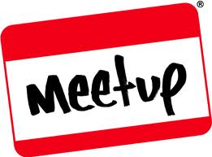
How to get involved
Can you please help us spread the word?
We are social, be sure that you have liked us, followed us, joined us, circled us, etc…
Share, like, retweet, +1 our posts and we will share, like and retweet and +1 your posts as well
Post a message about the Chicago Area DotNetNuke Users group to your Social Media circle of friends, family and neighbors
Tell people about us and help us grow this group

Slide 6
LinkedIn Group Statistics
Updated: 04/02/13

Slide 7
DotNetNuke Corporate
In The News

Slide 8
DotNetNuke in the News
DotNetNuke Press Releases
New DNN Social Integrates Communities into Corporate Websites to Optimize Customer Engagement - Tuesday, March 19, 2013
DNN World Announcement - Navin Nagiah

Slide 9
DotNetNuke in the News
New DNN Social Integrates Communities into Corporate Websites to Optimize Customer Engagement - Tuesday, March 19, 2013
DotNetNuke (DNN), whose award-winning web content management system (CMS) powers hundreds of thousands of websites around the world, today announced a social software solution aimed at optimizing customer engagement and loyalty through online communities. DNN Social gives businesses the ability to easily create and manage communities on their existing websites, giving end-users a one-stop destination for consuming content, exchanging ideas and interacting with other community members.

Slide 10
DotNetNuke in the News
DNN World Announcement - Navin Nagiah
We are postponing our next DNN World event to 2014. We would never post-pone this event if it weren¹t for very good & compelling reasons. So, why have we decided to post-pone the next DNN World event to 2014?
It is important and imperative for us, as a company, as a product, and as an ecosystem to both be prepared for, and be prepared to leverage these changes. We have 3 key strategic initiatives in progress to ensure we are prepared for the opportunities that these trends present us. You saw the first of these three initiatives come to fruition with the launch of our social product line. Before the end of the year, you will see at least 2, and perhaps 3 more such strategic initiatives come to fruition.
Once we complete our 3 key strategic initiatives, we believe we will be able to organize and host a much better event, a more relevant event, a more valuable event ­ an event that even as it is as celebratory as our last 2 events have been; is also simultaneously more forward-looking and purposeful. We promise you that while the delay is both unfortunate & a tad painful, the wait will be more than well worth it.

Slide 11
DotNetNuke in the News
Take Learning Beyond the Classroom with DNN Social
Wednesday, May 15th, 2013 9:00am – 10:00am PDT
Presenter:
Your Host: Clint Patterson - Sales Engineer, Trainer, Product Evangelist - DotNetNuke Corporation
Description:
DNN Social is a flexible solution that can be used in any number of online community scenarios. DNN Social can be used to manage online communities such as client/fan base communities, user-support networks, as well as online learning communities. Join us to see DNN Social being used in an online learning environment to engage with, motivate, and teach students in a unique and creative way. When teachers gamify their lesson plans learning becomes fun!
Using DNN Social in an online learning environment allows to students to create content and learn together through an engaging experience that goes beyond the walls of the school. Learning isn’t confined to the classroom and DNN Social helps your instructors to be more effective as teachers while also catering to the tech-savvy learning styles of today’s students.
Attend this webinar to learn the benefits of:
Making a learning experience social
Gamifying your objectives to encourage user participation
The flexibility of DNN Social
And much more!

Slide 12
DotNetNuke in the News
Tips From Forrester's Online Community Playbook with guest speaker
Wednesday, June 12th, 2013 9:00am – 10:00am PDT
Presenter:
Your Host: Kim Celestre, Senior Analyst, Forrester Research, Inc.
Description:
Are you ready to transform your site into an energetic, interactive hub of information and collaboration? Join us as guest Kim Celestre of Forrester Research shares how to establish a healthy and active online B2B community that delivers value to prospects, customers, and employees.
Tips from the Playbook include how to:
Develop a comprehensive strategy
Organize internal resources to meet objective
Learn from the best practices of other companies
Set the appropriate metrics to measure and monitor ongoing community health

Slide 13
Release Updates

Slide 14
Good Advice
NOTE: As with any release, we recommend you perform a complete file and database backup before performing any upgrade on a production website and that you first conduct a trial upgrade on a staging version of the site.
Following these guidelines will ensure that you are able to recover should any unforeseen problems arise during the upgrade process.

Slide 15
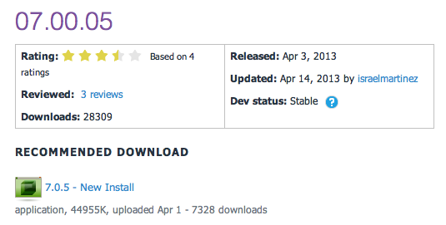
Release Updates
v07.00.05 Released
Prod: 04/03/13
16 Major Updates
4 Security Fixes
8 Modules update
0 Providers update

Slide 16
Major Highlights
v07.00.05 Major Highlights
Fixed issue in the Client Resource Manager where data URL's were removed when running the composite files option
Fixed issue when switching language from the control panel
Fixed issue that stopped the Telerik RadMenu and RadTabstring from rendering correctly when an HTML module is added to the same page
Fixed issue that stopped users from changing login settings
Fixed issue that stopped users from changing the settings in the event viewer.
Fixed post back issue when copying a page using the control panel
Implemented module icon override when updating to a new version of the product
Fixed image upload control rendering issue when using IE or Firefox
Fixed issue that makes the dashboard fail when running SQL Azure
Fixed export as XML in Dashboard feature when running on SQL Azure
Fixed upgrade issue when hosting a site in SQL Azure
Fixed password validation issue when adding a new user
Added auto complete when searching for devices to the Device Preview Management module
Fix issue when the user is upgrading DNN and recycles the app pool before calling the upgrade page
Fixed support pop ups feature when creating a new module from a manifest file
Fixed the To and From logic in the messaging module

Slide 17
Security Fixes
Security Fixes
Fixed permissions issue when uploading files through Service Framework requests
Fixed potential javascript injections on sites running multiple languages
Fixed potential javascript injections on modules that implement pop ups for edits
Implemented filters in the rich text editor to avoid the possibility of cross-site scripting issues
Modules
Log Viewer Module
Pages Module
Taxonomy Module
Dashboard Module
HTML Module
Member Directory Module
Messaging Module
Site Groups Module
Providers
None

Slide 18
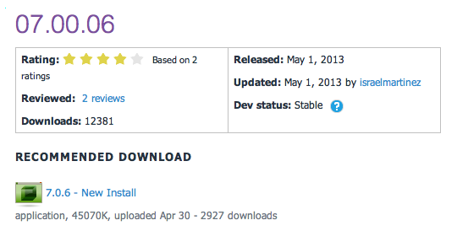
Release Updates
v07.00.06 Released
Prod: 04/03/13
24 Major Updates
0 Security Fixes
5 Modules update
0 Providers update

Slide 19
Major Highlights
v07.00.06 Major Highlights
Fixed issue that caused broken links when changing the name of a page
Added search capabilities in the page management section
Added new functionality to the Member Directory so that users can choose between the different search options
When creating a social group the newly created role group is now set as the default group
Implemented new functionality to allow users to hid the login button in the default skin
Removed the module and skin templates from the Starter Kit package
Fixed issue that shows an error when registration is set to unique display name
Fixed issue that made child site files not to show when managing sites
Fixed UX issue when changing the file size in the configuration management section
Fixed issue in the Journal module where followers could see posts that are meant for friends only
Fixed paging conflict between roles and users in the users' accounts screen
Added new functionality that allows users to see all the social groups they belong to
Fixed issue where separating a site from a group would not copy all the users
Fixed issue when creating a page from a template when the template has modules that are set to display on all pages
Removed the "-" from the invalid character list for page names
Fixed the styling in the date time picker to display the time
Fixed issue that shown the tokens when searching for pages
Fixed issue that made the site redirection management screen to not work correctly when pop ups are disabled
Fixed issue where exported templates point to the incorrect site settings
Fixed issue that caused Social Group Roles to be limited to the Global Role group
Fixed issue when page names include a ":" colon
Fixed issue where scheduler runs overlap when retry is set to a short interval
Fixed issue with modules that are expected to display in all pages and Content Localization is enabled.
Implemented auto-refresh functionality in the message center so that users can see updates in real time without refreshing the page

Slide 20
Security Fixes
Security Fixes
None
Modules
Device Preview Management Module
Pages Module
Journal Module
Member Directory Module
Site Groups Module
Providers
None

Slide 21
Minimum Requirements

Slide 22
V7.x Release Notes
Simplified Installer
The first thing you will notice is that the installer has been updated. Not only have we updated the look and feel, but we also simplified the overall install process. You shouldn’t have to click through a series of screens in order to just get your website running. With the 7.0 installer we have taken an approach that allows for the application to be installed quickly, but also provides you with the ability to configure advanced features if you wish. In the 7.0 CTP you will be able to experience the new install process and hopefully save yourself sometime along the way.
Web API Service Framework
In DotNetNuke 6.2 we introduced the Service Framework based on Microsoft MVC. As Shaun Walker mentioned in his blog a few months ago, we had the need to convert the Service Framework from MVC to Web API. This has been completed for the 7.0 CTP and is ready for testing. Scott Schlesier will have a series of blogs over the next few days that will provide you with everything you need to know about updating your services for 7.0.
Default.css Overhaul
The Default CSS in DotNetNuke has been completely overhauled. Ryan Martinez, UI/UX Designer for DotNetNuke Corp, does a great job explaining the reasoning behind these changes and what it means for designers. This is an area where we need a lot of feedback. If you are skin designer, module developer or just have a site using a third-party skin, we want to hear from you! Check out Ryan’s Blog to get the full details on the Default.css Facelift.
New Developer Skin
The skin that you will see in the 7.0 CTP is our new developer and admin skin. This is a very lightweight skin that has been optimized for performance so that we can provide administrators with the best experience possible. Don’t be surprised if you run into few bugs along the way as we are still working out a few issues with the skin.

Slide 23
CADUG Updates
Website & Social Media Websites

Slide 24
CADUG Website Hosting
The Chicago Area DotNetNuke Website Hosting is provided by:
Be sure to stop by and check out our sponsors for the best in DotNetNuke hosting
Sprocket Websites uses and recommends PowerDNN to its customers
Tony Valenti, CEO of PowerDNN

Slide 25
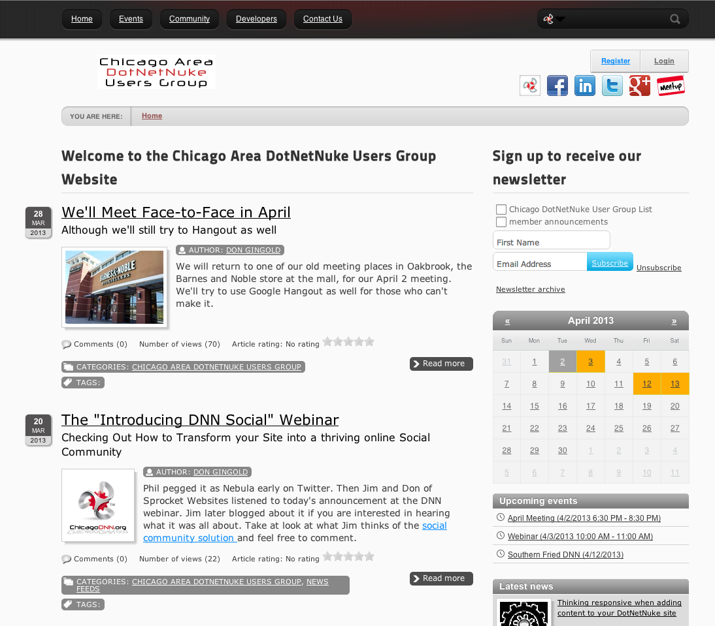
CADUG Website

Slide 26
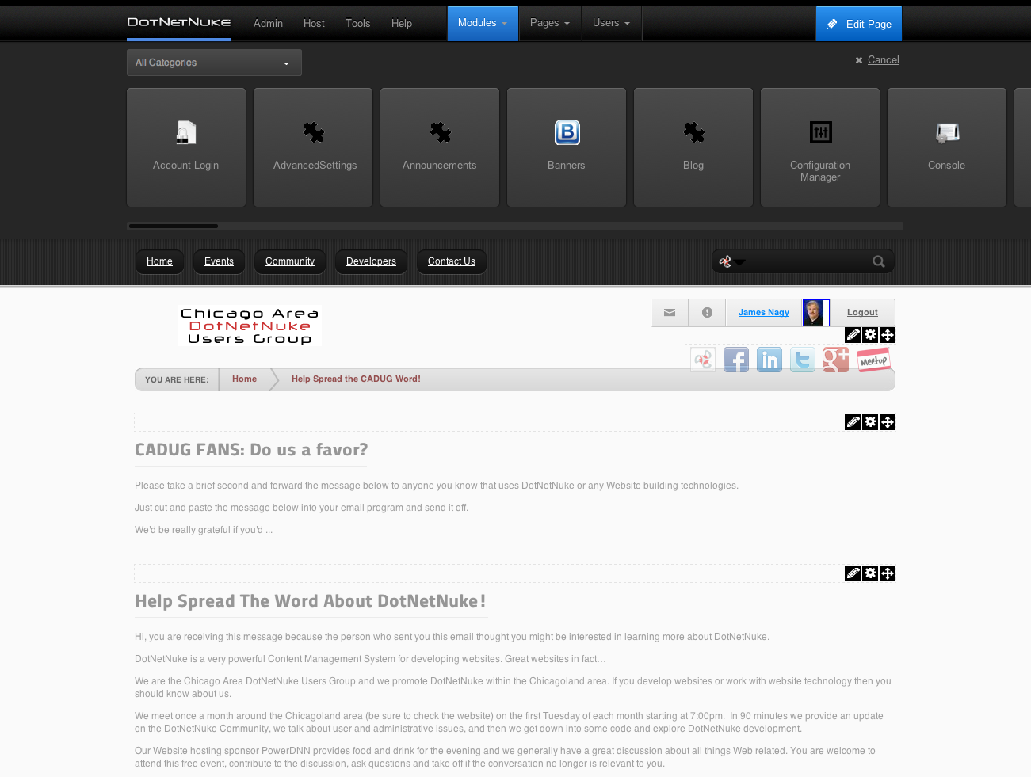
CADUG Website

Slide 27
Want to contribute to the Chicago Area DotNetNuke Website?
Ask Me How…

Slide 28
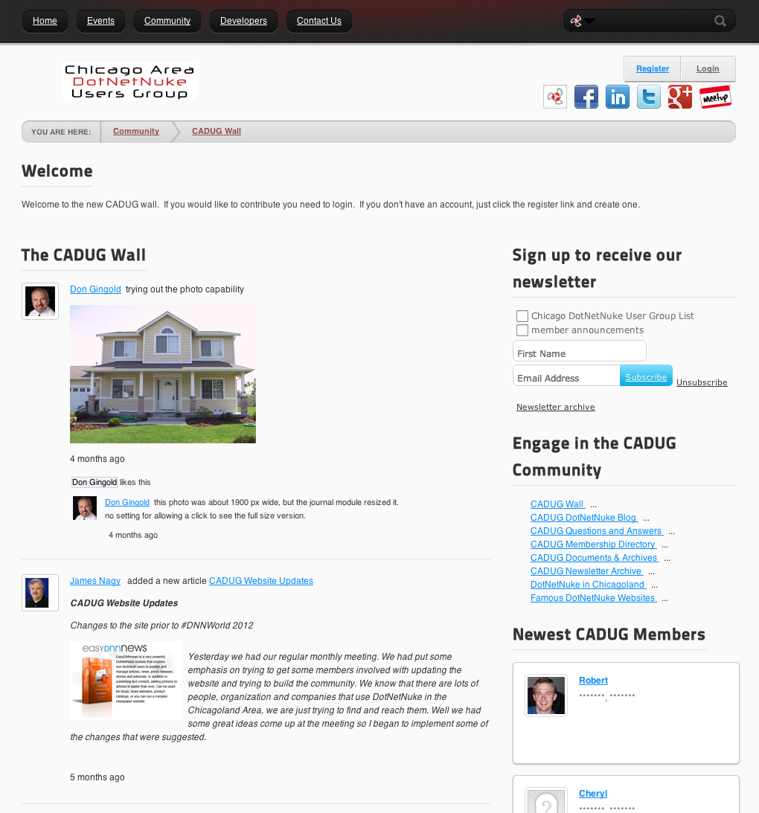

Slide 29
Want to help build a vibrant user community on the Chicago Area DotNetNuke Website?
Ask Me How…

Slide 30
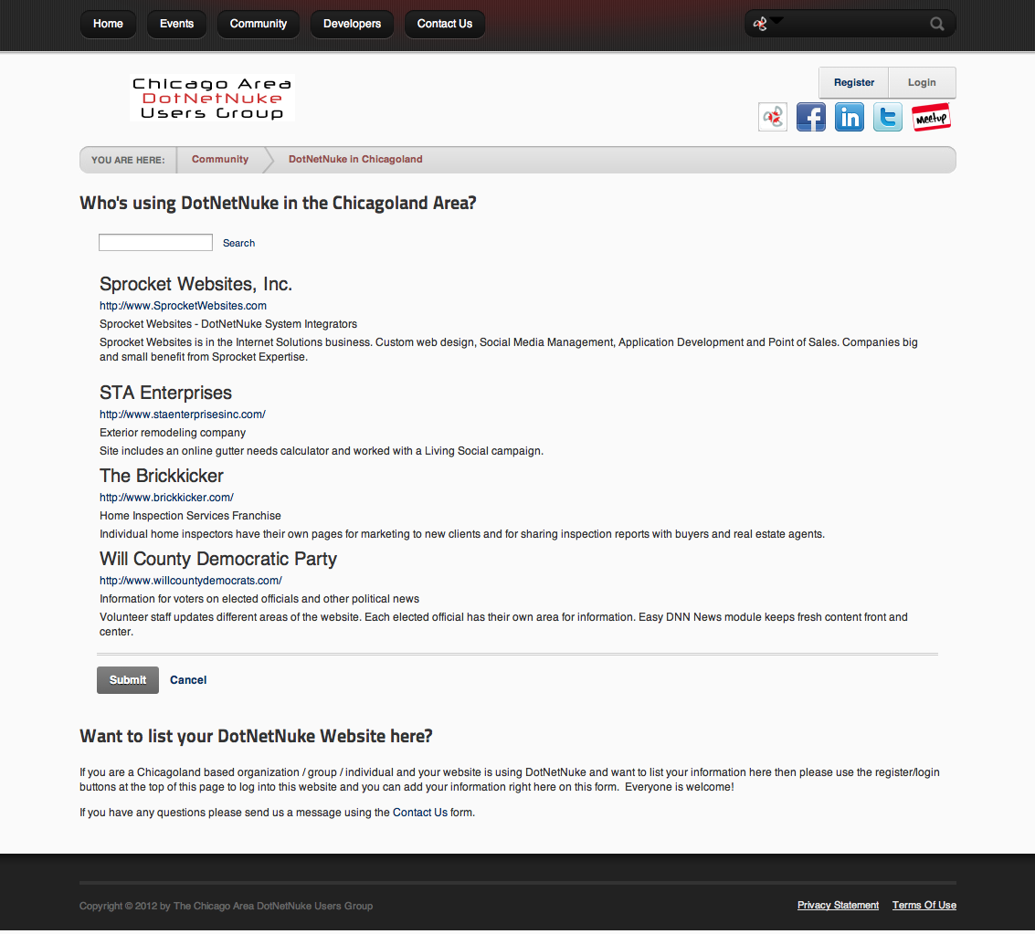

Slide 31
Want to see your website listed on the Chicago Area DotNetNuke Website?
Ask Me How…

Slide 32
Wrap Up / Q&A
Important Links
Thank You
ChicagoDNN.org
meetup.com/ChicagoDNN
twitter.com/ChicagoDNN
DotNetNuke.com
store.DotNetNuke.com
PowerDNN.com
James Nagy
Sprocket Websites, Inc.
Jim@SprocketWebsites.com
www.SprocketWebsites.com
@SprocketWebsite
630.344.9320

