Slide 1
Chicago Area DNN Users Group
Thank you to our sponsors!
For providing web hosting for the CADUG Website & Pizza and Soda at our face-to-face meetings
They are offering any CADUG member a 50% discount on their first month of a new subscription

Slide 2
New nuke stuff
What’s happening in the world of #DNN
February 12th, 2014 – Is Winter Over Yet?

Slide 3
Agenda
Social Media Update
Corporate Updates
Release Updates
Module Updates
DotNetNuke Products
CADUG Website Updates

Slide 4
How to get involved
Register at www.ChicagoDNN.org for news and announcements
Join the CAGUG Group on www.ChicagoDNN.com
Currently 239 users on the Website (up 5 from last report – Continued Growth)
Join the CADUG Group on www.DnnSoftware.com
Currently 65 active members (up 1 from last report)
Join the LinkedIn Group on www.LinkedIn.com
Currently 57 active members (same as last report)
Join the Facebook Group on www.Facebook.com/groups/cadug
Currently 29 active members (up 1 from last report)
Follow us now on Twitter: @ChicagoDNN
Currently 211 people following (up 30 from last report *BOOM*)
Currently following 344 people (up 14 from last report)
Join the Meetup Group on meetup.com/ChicagoDNN
Currently 52 active members (same as last report)
Last month of reporting on this group, we are shutting this down.
Join the CADUG Community on plus.google.com
Currently 45 active members (up 3 from last report)

Slide 5
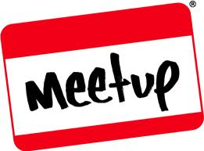
How to get involved
Can you please help us spread the word?
We are social, be sure that you have liked us, followed us, joined us, circled us, etc…
Share, like, retweet, +1 our posts and we will share, like and retweet and +1 your posts as well
Post a message about the Chicago Area DotNetNuke Users group to your Social Media circle of friends, family and neighbors
Tell people about us and help us grow this group

Slide 6
Dnn Corporate
Dnn In The News

Slide 7
Dnn Latest Press Releases
Cantarus Takes Home DNN's Partner of the Year Award for the Second Consecutive Year
2/12/2014
Cantarus has been chosen as DNN's Partner of the Year for the second consecutive year. Read the release for the details.

Slide 8
Dnn Corporate Blog
A Single Solution for Your Website Content and Community
Clint Patterson 2/10/2014 0 Comments
Why your website and your online community is best served from a single, integrated solution.

Slide 9
Dnn Corporate Blog
5 Things Great Content Marketing Blogs Have in Common
Dennis Shiao 2/10/2014 0 Comments
A list of blogs all content marketers should read. Up-vote, down-vote and add your own.

Slide 10
Dnn Corporate Blog
Steal These Community Management Tips from CMX Summit Presenters
Dennis Shiao 2/7/2014 0 Comments
Gain actionable community management tips that you can apply to your online community right away.

Slide 11
Dnn Corporate Blog
Features Available in Version 7 of our Content Management System (CMS)
Clint Patterson 2/5/2014 0 Comments
An overview of the many new and exciting features in version 7 of our CMS, Evoq Content.

Slide 12
Dnn Corporate Blog
Community Manager Insights: How to Create Sustained Engagement (Part 3)
Clint Patterson 2/4/2014 0 Comments
Part 3 of Clint Patterson's blog series on creating sustained engagement in online communities.

Slide 13
Dnn Corporate Blog
Community Manager Insights: How to Create Sustained Engagement (Part 2)
Clint Patterson 1/30/2014 0 Comments
Part 2 of Clint Patterson's blog series on creating sustained engagement in online communities.

Slide 14
Dnn Corporate Blog
Community Manager Insights: How to Create Sustained Engagement (Part 1)
Clint Patterson 1/29/2014 0 Comments
Clint Patterson provides tips for creating sustained engagement in online communities.

Slide 15
Dnn Corporate Blog
How Mark Schaefer Made a Splash with Content Shock (And What You Can Learn From Him)
Dennis Shiao 1/29/2014 0 Comments
What content marketers can learn from Mark Schaefer and Content Shock.

Slide 16
Dnn Corporate Blog
A Recap of Community Manager Appreciation Day 2014 #CMAD
Erika Heald 1/28/2014 0 Comments
Erika Heald provides a recap of Community Manager Appreciation Day 2014, a global event that celebrates community managers.

Slide 17
Dnn Corporate Blog
Healthy Online Communities: A 5-Step Plan to Get You Started
Dennis Shiao 1/27/2014 0 Comments
Dennis Shiao details a five step plan on getting started with your online community.

Slide 18
Dnn Corporate Blog
5 Reasons I Appreciate Community Managers
Jenise Fryatt 1/24/2014 0 Comments
Jenise Fryatt shares five reasons she appreciates community managers.

Slide 19
Dnn Corporate Blog
7 Traits to Screen for When Hiring a Community Manager
Erika Heald 1/23/2014 0 Comments
Erika Heald provides traits to screen for when hiring community managers for your organization.

Slide 20
Dnn Corporate Blog
A Product Manager’s Thoughts on Delivering Simple Products
Bruce Chapman 1/22/2014 0 Comments
Bruce Chapman shares thoughts on how to create really simple products.

Slide 21
Dnn Corporate Blog
How an Online Community Solution Can Improve Your Internal Communications
Clint Patterson 1/22/2014 1 Comments
We migrated our intranet to “Catalyst,” a private community powered by our online community solution, Evoq Social. The impact was immediate and the benefits continue.

Slide 22
Dnn Corporate Blog
5 Completely Surprising Marketing Tips Learned from Fifth Graders
Dennis Shiao 1/21/2014 0 Comments
Dennis Shiao went in to teach fifth graders about business and entrepreneurism. He came out with a few lessons (on Marketing) that he learned from observing the students.

Slide 23
Dnn Corporate Blog
An Interview on Community Management with Kelly Lux of #CMGRclass and #CMGRchat
Dennis Shiao 1/16/2014 0 Comments
We asked Kelly Lux (of #CMGRclass and #CMGRchat) some community management questions. She provided awesome and insightful answers.

Slide 24
Dnn Corporate Blog
Listening and Engaging in Online Customer Communities
Will Morgenweck 1/15/2014 0 Comments
Conversations are taking place all over the web. It is extremely difficult, if not impossible, for you to listen to all of them. That's where online customer communities come into play.

Slide 25
Dnn Corporate Blog
Why Content is the Fuel behind Online Community Engagement
Dennis Shiao 1/14/2014 0 Comments
Content is like the sun. Content fuels online communities and online community engagement. Read the post to learn about the importance of content to online community engagement.

Slide 26
Dnn Corporate Blog
Think Like a Product Designer When Launching Your Online Community
Dennis Shiao 1/14/2014 0 Comments
Steve Jobs was a brilliant product designer. He would have been a great online community manager. Read the full post to learn why.

Slide 27
Dnn Corporate Blog
A Software Executive's Advice to Developers
Bob Kruger 1/9/2014 0 Comments
Bob Kruger, our SVP Engineering, provides actionable advice to software developers. Read Bob's post to learn more.

Slide 28
Dnn Webinar Events
How Top Marketers at Mid-Size Companies Engage on Social Media
Wednesday, Feb 19, 2014 09:00 AM - 10:00 AM PST (GMT -05:00)
Presenter(s): Carter Hostelly and Karri Carlson, Leadtail with Dennis Shiao, DNN Corp.
Skill Level: All

Slide 29
Release Updates

Slide 30
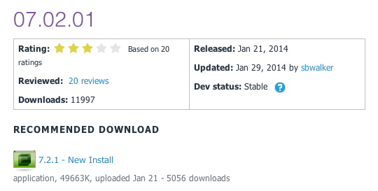
Release Updates
v07.02.01 Released
Prod: 01/21/14
53 Major Features
0 Security Fixes
0 Modules update
0 Providers update
7.2

Slide 31
Major Highlights
v07.02.01 Major Highlights
Fixed issue where .dnn7 manifest was not being utilized in module installation process
Fixed issue where restored user could not change his profile avatar
Added .ashx to regex filter for Do Not Redirect rule in advanced url management
Added various SQL database optimizations contributed by Sebastian Leupold
Fixed issue with rich text editor in Newsletters in Firefox
Fixed copy page so that all properties are copied
Fixed UI issue when managing Authentication providers
Fixed browser compatibility issue when managing Available Modules in Site Settings
Fixed defaults of billing and trial values when adding security roles
Added a 404 page to the blank site template
Fixed issue where config element in module manifest throws errors when XML Merge script is in separate file
Fixed terminology when changing password as Administrator
Fixed Console module so that it ignores pages that are not intended to be included in the menu
Fixed access control so that Deny permissions always ovveride Grant permissions
Fixed access control so that Navigate permission can be denied
Enhanced permissions grid so that full control specification can not be overridden for specific permissions
Enhanced control panel so that Stay In Edit Mode option is always available
Make application FIPS compliant
Fixed issue preventing DAM from being used in Group mode
Fixed javascript issue in DNNMenuProvider
Fixed access control so that module level permissions are observed for all individualpermission types
Disabled field validation when changing countries during registration
ModuleSettingsPresenterBased now instantiates ModuleSettings and TabModuleSettings
Fixed exception when composing new message to user
GetUserRoles will now return an empty list if the user is not valid
Made Group pending notification URLs absolute

Slide 32
Major Highlights
v07.02.01 Major Highlights
Allow a user using the Windows Live authentication provider to be a member of multiple portals
Removed inline style in Logo skin object
Fixed Member Directory issue where the same user is displayed multiple times
Added stored procedure to prevent error when uninstalling dashboard extension
Improved Newsletters so you can send to Social Groups as well as Security Roles
Fixed issue where page with a future publish date can not be edited
Allow a user to specify both a date and time for publishing in module settings
Fixed issue where UserInfo object did not contain LastIPAddress
Fixed Site Group behavior so that Site Settings are populated with current portal properties
Improved performance of loading folders that contain a large volume of files
Fixed scheduler so that Application_Start is recognized when using Request mode
Fixed search by tag functionality
Fixed Users Online so that it is thread-safe
Enhancement so that Google Analytics does not track admin or host user activity
Enhanced Test SMTP options so that it tells you who the email was sent from and to
Fixed issue preventing the closing of the "Welcome to Your Installation" pop up
Search crawler enhanced to include host pages
Fixed issue causing SendMail to crash when sending blank value for to, cc or bcc
Fixed user profile so that users can view their friends profile info if security is set to Friends
Fixed Splash page behavior
Fixed issues where updating a journal item was creating a new record instead of updating existing one
Fixed issue where upgrading from an older version was not cleaning up auth systems, providers and optional modules
Enhanced uploading new extension experience to show progress indicator
Fixed issue where User could not reply to Message
Added new host setting to optionally disable critical error reports displayed in page
Fixed upgrade issue if previous version of module creator was installed
Fixed an issue where user folders were not deleted when a user was deleted

Slide 33
Security Fixes
Security Fixes
None
Modules
None
Providers
None

Slide 34
Module Updates

Slide 35
DNN Modules - Overview
DotNetNuke® Skins
Wed Sep 14, 2011
DotNetNuke® Announcements
Sun Jun 30, 2013
DNN Blog
Tue Jan 28, 2014
DotNetNuke® Documents
Fri Jun 7, 2013
DotNetNuke® Events
Thu Feb 6, 2014
DotNetNuke® FAQ
Thu Oct 10, 2013
DotNetNuke® Feedback
Fri Oct 4, 2013
DotNetNuke® Forum
Wed Jul 20, 2011
DotNetNuke® Gallery
Sun Jul 3, 2011
DotNetNuke® Iframe
Sun Jun 30, 2013
DotNetNuke® Links
Sun Jun 30, 2013
DotNetNuke® News Feeds
Thu Mar 28, 2013
DotNetNuke® Media
Sun Feb 9, 2014
DotNetNuke® Reports
Mon Feb 10, 2014
DotNetNuke® Repository
Thu Dec 22, 2011
DotNetNuke® Store
Sun Nov 18, 2012
DotNetNuke® Survey
Sun Jul 3, 2011
DNN® Form and List
Thu Oct 3, 2013
DotNetNuke® Users Online
Thu Jun 11, 2009
DotNetNuke® Wiki
Tue Nov 5, 2013
DotNetNuke® XML
Thu Sep 15, 2011
DotNetNuke® Auth: Active Directory
Thu Mar 14, 2013

Slide 36
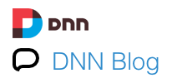
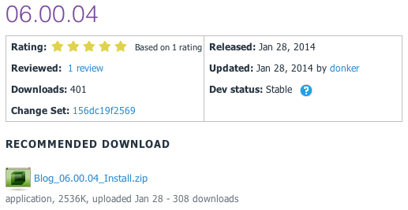
DNN Blog
v06.00.04 Released
Prod: 01/28/14

Slide 37
Release Notes
v06.00.04 Release
Switched to Colorbox as lightbox plugin for default template as Fancybox was out of date and has switched to a non-commercial license
Fix to image handler so it will include mime-type in response
Include plain text author in feed RSS and not just the default RSS 2 fashion
Resolved issues with downloading old posts and post categories in WLW
Fixed width issues on a number of admin screen text boxes

Slide 38
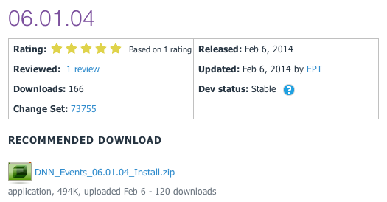
DNN Events
v06.01.04 Released
Prod: 02/06/14

Slide 39
Release Notes
Release notes DNN Events 06.01.04
Events 06.01.03 will work for any DNN version 6.2.7 and up. Full details on the changes can be found in great detail at the issues tab.
BUG FIXES
Fixed search engine indexing failure
Fixed date layout on DNN 7 in edit view
Improved some html generation of the calendar!!
NOTE
Although the minimum (technical level) DNN version is specified as 6.2.7, we strongly advise to start with DNN 7.2.o or higher if you use IE11, since the (Telerik based) date picker in DNN 6.2.7. is not correctly formatted in IE11. This is resolved in DNN 7.2.0 . NB Chrome and FireFox are not affected.

Slide 40
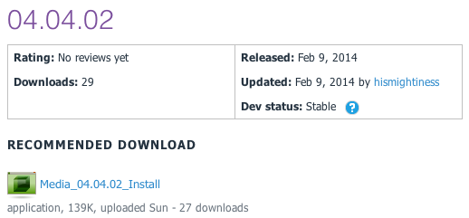
DNN Media
v04.04.02 Released
Prod: 02/09/14

Slide 41
Release Notes
v04.04.02 Release
This release has the follow new features and updates:
Tested for version 07.02.00 compatibility
Updated oEmbed to version 00.03.00
Added missing description below images
Fixed oEmbed SSL providers (can use https now)
Fixed CSS conflicts with fieldsets
Removed NewtonsoftJSON dependency
Fixed issue with sub-directories being used for local media
Fixed URL that is generated
System Requirements
DotNetNuke v07.02.00 or newer
.Net Framework v4.0 or newer
SQL Server 2008 or newer

Slide 42
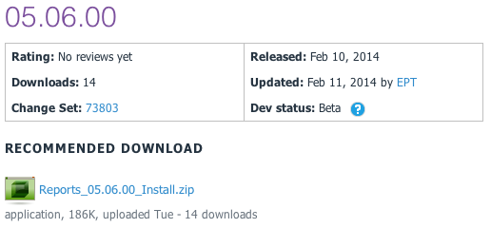
DNN Reports
v05.06.00 Released
Prod: 02/10/14

Slide 43
Release Notes
v05.06.00 Release
Release to make DNN Reports work for DNN 7.0.0 and up
BUG FIXES
Fixed xslt visualizer xsl file retrieval
Fixed HTML visualizer html file retrieval
ENHANCEMENTS
Made the dataprovider scripts SQL Azure compliant

Slide 44
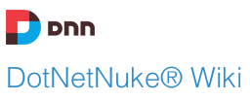
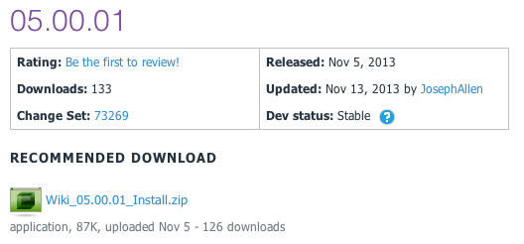
DNN Wiki
v05.00.01 Released
Prod: 11/05/13

Slide 45
Release Notes
Enhancements:
Journal Integration
Added "Delete Confirmation"
"Add Page" button to "All Pages View"
Big Fixes
Pressing Enter on Wiki Search Page Displays Search Results
RSS Feeds display correctly

Slide 46
CADUG Updates
Website & Social Media Websites

Slide 47
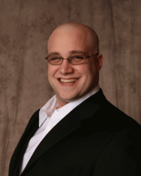
CADUG Website Hosting
The Chicago Area DotNetNuke Website Hosting is provided by:
Be sure to stop by and check out our sponsors for the best in DotNetNuke hosting
Sprocket Websites uses and recommends PowerDNN to its customers
Tony Valenti, CEO of PowerDNN

Slide 48
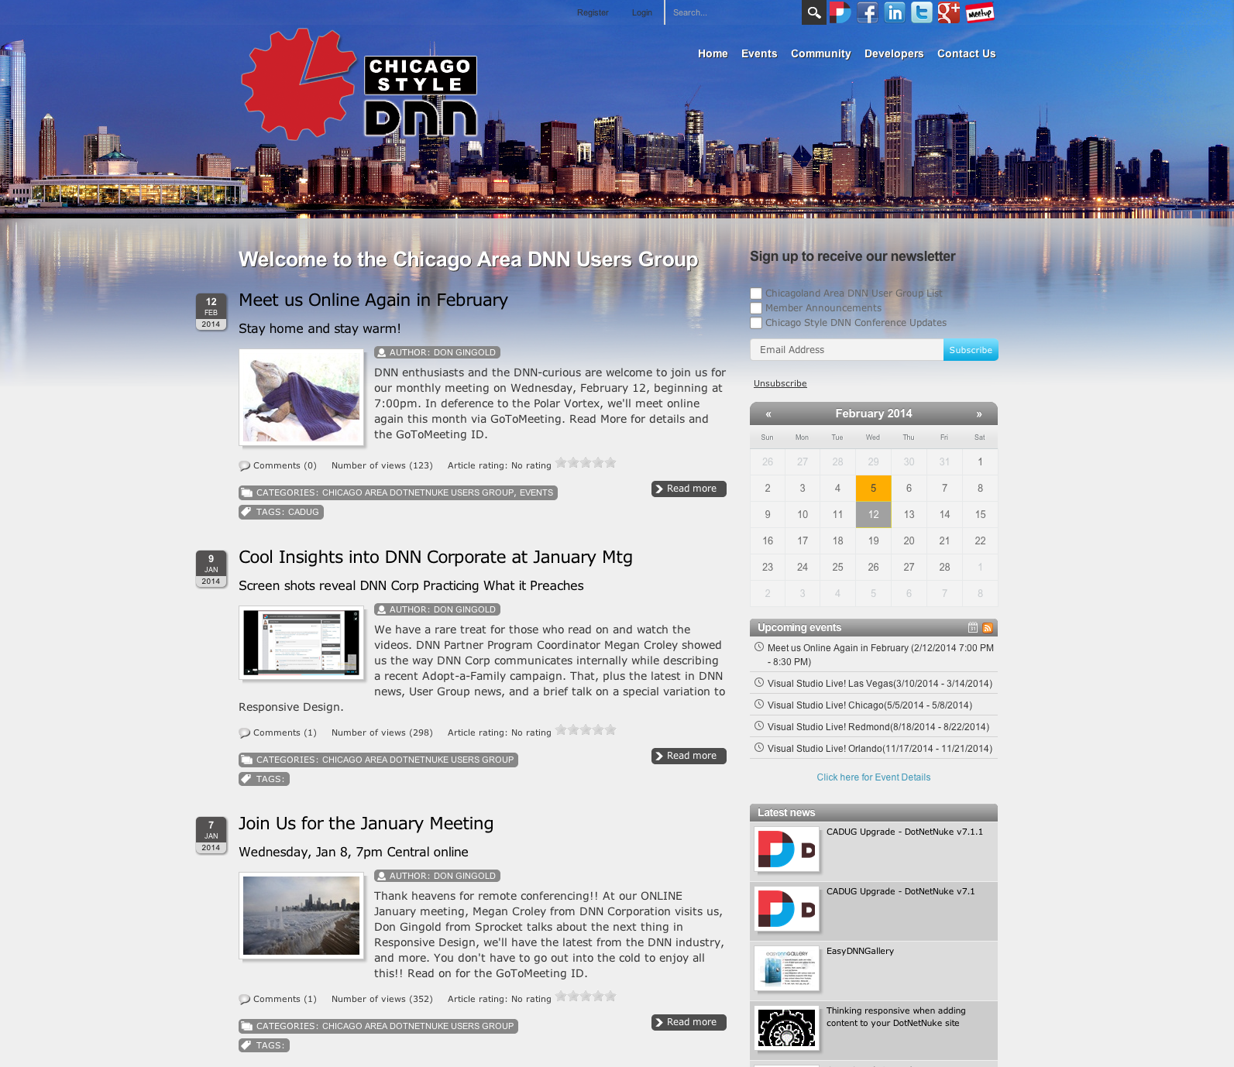
CADUG Website

Slide 49
Want to contribute to the Chicago Area DotNetNuke Website?
Ask Me How…

Slide 50
Wrap Up / Q&A
Important Links
Thank You
ChicagoDNN.org
meetup.com/ChicagoDNN
twitter.com/ChicagoDNN
DotNetNuke.com
store.DotNetNuke.com
PowerDNN.com
James Nagy
Sprocket Websites, Inc.
Jim@SprocketWebsites.com
www.SprocketWebsites.com
@SprocketWebsite
630.344.9320

