Slide 1
Chicago Area DNN Users Group
Thank you to our sponsors!
For providing web hosting for the CADUG Website & Pizza and Soda at our face-to-face meetings
They are offering any CADUG member a 50% discount on their first month of a new subscription

Slide 2
New nuke stuff
What’s happening in the world of #DNN
March 12th, 2014 – 1st Meeting post Daylight Savings Time

Slide 3
Agenda
Social Media Update
Corporate Updates
Release Updates
Module Updates
DotNetNuke Products
CADUG Website Updates

Slide 4
How to get involved
Register at www.ChicagoDNN.org for news and announcements
Join the CAGUG Group on www.ChicagoDNN.com
Currently 250 users on the Website (up 11 from last report – Continued Growth)
Join the CADUG Group on www.DnnSoftware.com
Currently 67 active members (up 2 from last report)
Join the LinkedIn Group on www.LinkedIn.com
Currently 57 active members (same as last report)
Join the Facebook Group on www.Facebook.com/groups/cadug
Currently 30 active members (up 1 from last report)
Follow us now on Twitter: @ChicagoDNN
Currently 215 people following (up 3 from last report)
Currently following 352 people (up 8 from last report)
Join the CADUG Community on plus.google.com
Currently 45 active members (up 3 from last report)

Slide 5
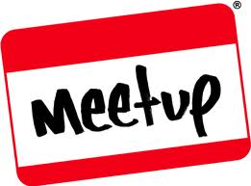
How to get involved
Can you please help us spread the word?
We are social, be sure that you have liked us, followed us, joined us, circled us, etc…
Share, like, retweet, +1 our posts and we will share, like and retweet and +1 your posts as well
Post a message about the Chicago Area DotNetNuke Users group to your Social Media circle of friends, family and neighbors
Tell people about us and help us grow this group

Slide 6
Dnn Corporate
Dnn In The News

Slide 7
Dnn - In The News
Five Rules to Select the Right Online Community Platform
2/14/2014
CMSWire summarizes a recent DNN-sponsored webinar on how to select an online community platform.

Slide 8
Dnn Latest Press Releases
DNN and Leadtail Announce New Social Insights Report on Top Marketers at Mid-Size Companies
2/18/2014
DNN and Leadtail collaborated on a new report, "How Top Marketers at Mid-Size Companies Engage on Twitter."

Slide 9
Dnn Latest Press Releases
DNN's Evoq Social Amplifies and Encourages Online Community Engagement With New Features
3/4/2014
The latest version of our award-winning online community solution now features Group Spaces and Directory.

Slide 10
Dnn Corporate Blog
Community Manager Insights: Why Your Community Needs a Good Quarterback (Part 2)
Clint Patterson 3/10/2014 0 Comments
Part 2 of our blog series on why your online community needs a strong quarterback.

Slide 11
Dnn Corporate Blog
The Story Behind #ContentChat: The Leading Twitter Chat on Content Marketing
Dennis Shiao 3/10/2014 0 Comments
The story behind #ContentChat, the leading Twitter chat on the topic of content marketing.

Slide 12
Dnn Corporate Blog
Steal These Community Management Tips from CMX Summit Presenters
Dennis Shiao 2/7/2014 0 Comments
Gain actionable community management tips that you can apply to your online community right away.

Slide 13
Dnn Corporate Blog
Community Manager Insights: Why Your Community Needs a Good Quarterback (Part 1)
Clint Patterson 3/5/2014 5 Comments
Part 1 of our blog series that details why community managers are the quarterbacks of their community.

Slide 14
Dnn Corporate Blog
New Features in Evoq Social: Group Spaces, Group Directory and Much More
Chris Paterra 3/3/2014 0 Comments
DNN Product Manager Chris Paterra shares details on exciting new features available in the latest release of Evoq Social.

Slide 15
Dnn Corporate Blog
10 Ways DNN Can Improve Your Website SEO
Bruce Chapman 3/3/2014 2 Comments
10 ways you can improve the SEO of your website using DNN's Content Management System.

Slide 16
Dnn Corporate Blog
How to Balance Data-Driven Marketing with Emotion and Storytelling
Navin V Nagiah 2/25/2014 1 Comments
Navin Nagiah's take on how to balance data-driven marketing with emotion and storytelling.

Slide 17
Dnn Corporate Blog
Engage Influencers on Twitter in 8 Easy Steps
Dennis Shiao 2/21/2014 0 Comments
Follow these eight steps and start engaging with influencers on Twitter.

Slide 18
Dnn Corporate Blog
How I Become a More Effective Sales Engineer
Clint Patterson 2/20/2014 0 Comments
Running our Evoq Suite in the Cloud in a production environment has given me valuable experiences that help me become a more effective Sales Engineer.

Slide 19
Dnn Corporate Blog
Cantarus and DNN: Expertise and Imagination Deliver Outstanding Results
Bob Cortale 2/20/2014 0 Comments
DNN Partner Cantarus built a world-class team of developers who are technical, creative, and determined to deliver a product that exceeds their customer’s expectations.

Slide 20
Dnn Corporate Blog
Learn How Top Marketers at Mid-Size Companies Engage on Social Media
Dennis Shiao 2/14/2014 0 Comments
Gain actionable insights on how marketers at mid-size companies engage on social media.

Slide 21
Dnn Corporate Blog
[INFOGRAPHIC] How to Create Contagious Content
Dennis Shiao 2/12/2014 0 Comments
An infographic that dissects six principles behind creating contagious content.

Slide 22
Dnn Corporate Blog
A Product Manager’s Thoughts on Delivering Simple Products
Bruce Chapman 1/22/2014 0 Comments
Bruce Chapman shares thoughts on how to create really simple products.

Slide 23
Dnn Corporate Blog
How an Online Community Solution Can Improve Your Internal Communications
Clint Patterson 1/22/2014 1 Comments
We migrated our intranet to “Catalyst,” a private community powered by our online community solution, Evoq Social. The impact was immediate and the benefits continue.

Slide 24
Dnn Corporate Blog
5 Completely Surprising Marketing Tips Learned from Fifth Graders
Dennis Shiao 1/21/2014 0 Comments
Dennis Shiao went in to teach fifth graders about business and entrepreneurism. He came out with a few lessons (on Marketing) that he learned from observing the students.

Slide 25
Dnn Corporate Blog
An Interview on Community Management with Kelly Lux of #CMGRclass and #CMGRchat
Dennis Shiao 1/16/2014 0 Comments
We asked Kelly Lux (of #CMGRclass and #CMGRchat) some community management questions. She provided awesome and insightful answers.

Slide 26
Dnn Corporate Blog
Listening and Engaging in Online Customer Communities
Will Morgenweck 1/15/2014 0 Comments
Conversations are taking place all over the web. It is extremely difficult, if not impossible, for you to listen to all of them. That's where online customer communities come into play.

Slide 27
Dnn Corporate Blog
Why Content is the Fuel behind Online Community Engagement
Dennis Shiao 1/14/2014 0 Comments
Content is like the sun. Content fuels online communities and online community engagement. Read the post to learn about the importance of content to online community engagement.

Slide 28
Dnn Corporate Blog
Think Like a Product Designer When Launching Your Online Community
Dennis Shiao 1/14/2014 0 Comments
Steve Jobs was a brilliant product designer. He would have been a great online community manager. Read the full post to learn why.

Slide 29
Dnn Corporate Blog
A Software Executive's Advice to Developers
Bob Kruger 1/9/2014 0 Comments
Bob Kruger, our SVP Engineering, provides actionable advice to software developers. Read Bob's post to learn more.

Slide 30
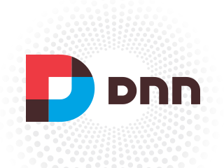
Dnn Webinar Events
How to Improve Your SEO with DNN
Wednesday, Mar 26, 2014 09:00 AM - 10:00 AM PDT (GMT -04:00)
Presenter(s): Bruce Chapman, Product Manager, DNN Corp.
Skill Level: All

Slide 31
Release Updates

Slide 32
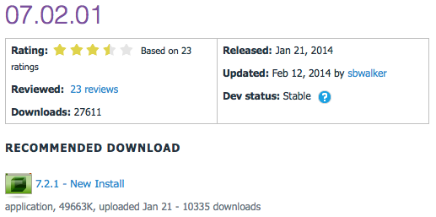
Release Updates
v07.02.01 latest release
Prod: 01/21/14
53 Major Features
0 Security Fixes
0 Modules update
0 Providers update
7.2

Slide 33
Major Highlights
v07.02.01 Major Highlights
Fixed issue where .dnn7 manifest was not being utilized in module installation process
Fixed issue where restored user could not change his profile avatar
Added .ashx to regex filter for Do Not Redirect rule in advanced url management
Added various SQL database optimizations contributed by Sebastian Leupold
Fixed issue with rich text editor in Newsletters in Firefox
Fixed copy page so that all properties are copied
Fixed UI issue when managing Authentication providers
Fixed browser compatibility issue when managing Available Modules in Site Settings
Fixed defaults of billing and trial values when adding security roles
Added a 404 page to the blank site template
Fixed issue where config element in module manifest throws errors when XML Merge script is in separate file
Fixed terminology when changing password as Administrator
Fixed Console module so that it ignores pages that are not intended to be included in the menu
Fixed access control so that Deny permissions always ovveride Grant permissions
Fixed access control so that Navigate permission can be denied
Enhanced permissions grid so that full control specification can not be overridden for specific permissions
Enhanced control panel so that Stay In Edit Mode option is always available
Make application FIPS compliant
Fixed issue preventing DAM from being used in Group mode
Fixed javascript issue in DNNMenuProvider
Fixed access control so that module level permissions are observed for all individualpermission types
Disabled field validation when changing countries during registration
ModuleSettingsPresenterBased now instantiates ModuleSettings and TabModuleSettings
Fixed exception when composing new message to user
GetUserRoles will now return an empty list if the user is not valid
Made Group pending notification URLs absolute

Slide 34
Major Highlights
v07.02.01 Major Highlights
Allow a user using the Windows Live authentication provider to be a member of multiple portals
Removed inline style in Logo skin object
Fixed Member Directory issue where the same user is displayed multiple times
Added stored procedure to prevent error when uninstalling dashboard extension
Improved Newsletters so you can send to Social Groups as well as Security Roles
Fixed issue where page with a future publish date can not be edited
Allow a user to specify both a date and time for publishing in module settings
Fixed issue where UserInfo object did not contain LastIPAddress
Fixed Site Group behavior so that Site Settings are populated with current portal properties
Improved performance of loading folders that contain a large volume of files
Fixed scheduler so that Application_Start is recognized when using Request mode
Fixed search by tag functionality
Fixed Users Online so that it is thread-safe
Enhancement so that Google Analytics does not track admin or host user activity
Enhanced Test SMTP options so that it tells you who the email was sent from and to
Fixed issue preventing the closing of the "Welcome to Your Installation" pop up
Search crawler enhanced to include host pages
Fixed issue causing SendMail to crash when sending blank value for to, cc or bcc
Fixed user profile so that users can view their friends profile info if security is set to Friends
Fixed Splash page behavior
Fixed issues where updating a journal item was creating a new record instead of updating existing one
Fixed issue where upgrading from an older version was not cleaning up auth systems, providers and optional modules
Enhanced uploading new extension experience to show progress indicator
Fixed issue where User could not reply to Message
Added new host setting to optionally disable critical error reports displayed in page
Fixed upgrade issue if previous version of module creator was installed
Fixed an issue where user folders were not deleted when a user was deleted

Slide 35
Security Fixes
Security Fixes
None
Modules
None
Providers
None

Slide 36
Module Updates

Slide 37
DNN Modules - Overview
DotNetNuke® Skins
Wed Sep 14, 2011
DotNetNuke® Announcements
Sun Jun 30, 2013
DNN Blog
Tue Jan 28, 2014
DotNetNuke® Documents
Fri Jun 7, 2013
DotNetNuke® Events
Thu Feb 6, 2014
DotNetNuke® FAQ
Wed Feb 12, 2014
DotNetNuke® Feedback
Fri Oct 4, 2013
DotNetNuke® Forum
Wed Jul 20, 2011
DotNetNuke® Gallery
Sun Jul 3, 2011
DotNetNuke® Iframe
Sun Jun 30, 2013
DotNetNuke® Links
Fri Mar 7, 2014
DotNetNuke® News Feeds
Thu Mar 28, 2013
DotNetNuke® Media
Sun Feb 9, 2014
DotNetNuke® Reports
Mon Feb 10, 2014
DotNetNuke® Repository
Thu Dec 22, 2011
DotNetNuke® Store
Sun Nov 18, 2012
DotNetNuke® Survey
Sun Jul 3, 2011
DNN® Form and List
Thu Oct 3, 2013
DotNetNuke® Users Online
Thu Jun 11, 2009
DotNetNuke® Wiki
Tue Nov 5, 2013
DotNetNuke® XML
Thu Sep 15, 2011
DotNetNuke® Auth: Active Directory
Thu Mar 14, 2013

Slide 38
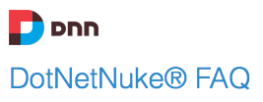
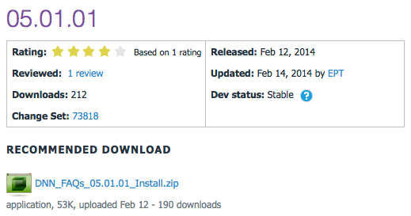
DotNetNuke FAQ
v05.01.01 Released
Prod: 01/28/14

Slide 39
Release Notes
v05.01.01 Release
RELEASE NOTES
FAQ (Frequently Asked Questions) 05.01.01 will work for any DNN version 7.0.6 and up.
BUG FIXES
Search items indexed clean of HTML tags
Icon URL for edit question corrected
CHANGES
Search item date changed from createdate/time to modify date/time

Slide 40
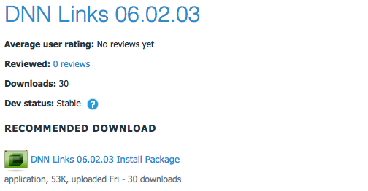
DNN Links
v06.02.03 Released
Prod: 03/07/14

Slide 41
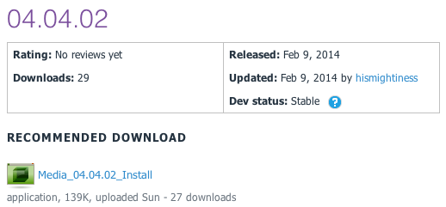
DNN Media
v04.04.02 Released
Prod: 02/09/14

Slide 42
Release Notes
v04.04.02 Release
This release has the follow new features and updates:
Tested for version 07.02.00 compatibility
Updated oEmbed to version 00.03.00
Added missing description below images
Fixed oEmbed SSL providers (can use https now)
Fixed CSS conflicts with fieldsets
Removed NewtonsoftJSON dependency
Fixed issue with sub-directories being used for local media
Fixed URL that is generated
System Requirements
DotNetNuke v07.02.00 or newer
.Net Framework v4.0 or newer
SQL Server 2008 or newer

Slide 43
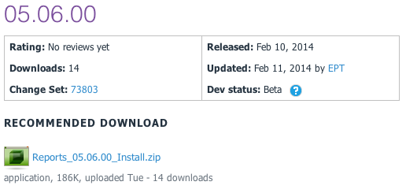
DNN Reports
v05.06.00 Released
Prod: 02/10/14

Slide 44
Release Notes
v05.06.00 Release
Release to make DNN Reports work for DNN 7.0.0 and up
BUG FIXES
Fixed xslt visualizer xsl file retrieval
Fixed HTML visualizer html file retrieval
ENHANCEMENTS
Made the dataprovider scripts SQL Azure compliant

Slide 45
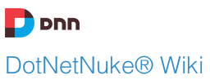
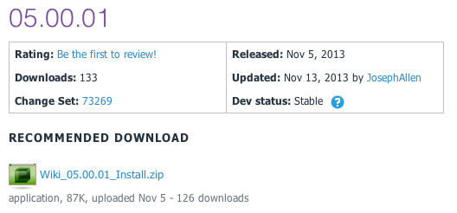
DNN Wiki
v05.00.01 Released
Prod: 11/05/13

Slide 46
Release Notes
Enhancements:
Journal Integration
Added "Delete Confirmation"
"Add Page" button to "All Pages View"
Big Fixes
Pressing Enter on Wiki Search Page Displays Search Results
RSS Feeds display correctly

Slide 47
CADUG Updates
Website & Social Media Websites

Slide 48
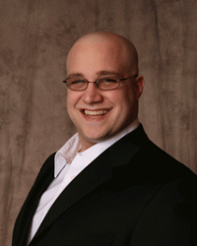
CADUG Website Hosting
The Chicago Area DotNetNuke Website Hosting is provided by:
Be sure to stop by and check out our sponsors for the best in DotNetNuke hosting
Sprocket Websites uses and recommends PowerDNN to its customers
Tony Valenti, CEO of PowerDNN

Slide 49
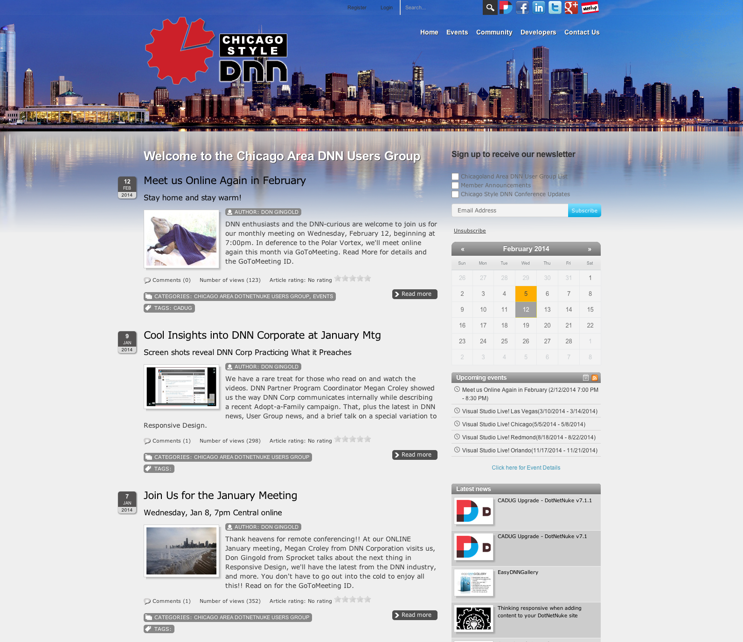
CADUG Website

Slide 50
Want to contribute to the Chicago Area DotNetNuke Website?
Ask Me How…

Slide 51
Wrap Up / Q&A
Important Links
Thank You
ChicagoDNN.org
meetup.com/ChicagoDNN
twitter.com/ChicagoDNN
DotNetNuke.com
store.DotNetNuke.com
PowerDNN.com
James Nagy
Sprocket Websites, Inc.
Jim@SprocketWebsites.com
www.SprocketWebsites.com
@SprocketWebsite
630.344.9320

