Slide 1
Chicago Area DNN Users Group
Thank you to our sponsors!
For providing web hosting for the CADUG Website & Pizza and Soda at our face-to-face meetings
They are offering any CADUG member a 50% discount on their first month of a new subscription

Slide 2
New nuke stuff
What’s happening in the world of #DNN
July 9th, 2014 – Mid Summer Nights

Slide 3
Agenda
Social Media Update
Corporate Updates
Release Updates
Module Updates
DotNetNuke Products
CADUG Website Updates

Slide 4
How to get involved
Register at www.ChicagoDNN.org for news and announcements
Join the CAGUG Group on www.ChicagoDNN.com
Currently 515 members on the Website (Spam accounts needs review)
Join the CADUG Group on www.DnnSoftware.com
Currently 72 active members (same as last report)
Join the LinkedIn Group on www.LinkedIn.com
Currently 61 active members (same as last report)
Join the Facebook Group on www.Facebook.com/groups/cadug
Currently 35 active members (same as last report)
Follow us now on Twitter: @ChicagoDNN
Currently 287 people following (up 12 from last report)
Currently following 893 people (up 1 from last report)
Join the CADUG Community on plus.google.com
Currently 49 active members (up 1 from last report)

Slide 5
How to get involved
Can you please help us spread the word?
We are social, be sure that you have liked us, followed us, joined us, circled us, etc…
Share, like, retweet, +1 our posts and we will share, like and retweet and +1 your posts as well
Post a message about the Chicago Area DotNetNuke Users group to your Social Media circle of friends, family and neighbors
Tell people about us and help us grow this group

Slide 6
Dnn Corporate
Dnn In The News

Slide 7
Dnn In The News Articles
Last Post
6/21/2014

Slide 8
Dnn Latest Press Releases
Nothing new since 5/5/2014

Slide 9
Dnn Corporate Blog
Smart Advice from Salesforce’s Content Marketing Manager on What You’re NOT Doing (and More)
Smart content marketing advice from Matt Wesson of Salesforce, covering content strategy, content measurement and more.
Posted on 8/11/2014 by Dennis Shiao

Slide 10
Dnn Corporate Blog
Now Available: eBooks on Branded Online Communities
DNN recently created a number of useful resources on branded online communities. Read our post for the full details.
Posted on 8/7/2014 by Dennis Shiao

Slide 11
Dnn Corporate Blog
Associations: Your 10 Step Plan to Building an Online Member Community
For associations, an online member community can help you achieve active and sustainable member engagement. A 10 step plan to get your community launched.
Posted on 7/31/2014 by Dennis Shiao

Slide 12
Dnn Corporate Blog
What is Costing US Companies $83 Billion Per Year?
Mary Cauwels shares insights on how Customer Care communities can help organizations who want to take customer retention seriously.
Posted on 7/25/2014 by Mary Cauwels

Slide 13
Dnn Corporate Blog
Your One Stop Shop to Selecting an Online Community Platform
In the market for an online community platform? Have a look through a number of resources that assist in your evaluation.
Posted on 7/23/2014 by Dennis Shiao

Slide 14
Dnn Webinar Events
The ROI of Evoq Content
Tuesday, Aug 19, 2014 09:00 AM - 10:00 AM PDT (GMT -04:00)
Presenter(s): Mary Cauwels, Director of Product Marketing, DNN Corp.
Skill Level: all

Slide 15
Release Updates

Slide 16
Release Updates
No new release

Slide 17
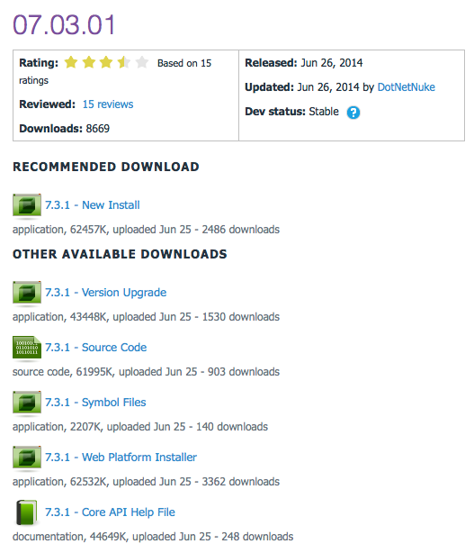
Release Updates
v07.03.01 latest release
Prod: 06/26/14
10 Major Features
0 Security Fixes
0 Modules update
0 Providers update
7.3

Slide 18
Major Highlights
v07.03.01 Major Highlights
Updated jQuery.RequestRegistration to also include jquery-migrate ( which many third party skins rely on )
Added back missing API methods to preserve binary compatibility
Update 51 Degrees V3 to the latest assembly and data file
Fixed case sensitivity issues with the scheduler and server names
Rollback change to exclude portal.css by default
Rollback to previous version of SharpZipLib assembly to preserve backward compatibility
Fixed permission grid so that you can add additional roles
Fixed user profile page alignment issues
Fixed upgrade issue installing Knockout
Fixed refactoring issue that would cause issues creating new pages

Slide 19
Security Fixes
Security Fixes
None
Modules
None
Providers
None

Slide 20
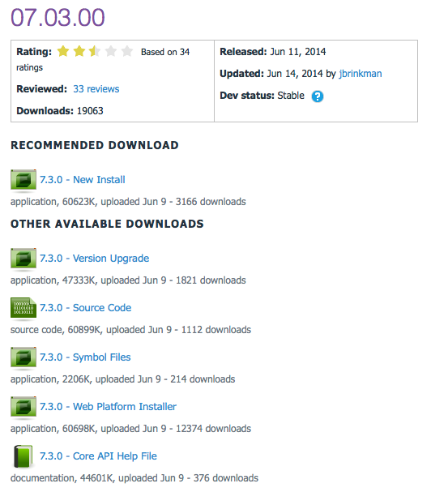
Release Updates
v07.03.00 latest release
Prod: 06/26/14
7 Major Features
0 Security Fixes
0 Modules update
0 Providers update
7.3

Slide 21
Major Highlights
v07.03.00 Major Highlights
The theme for DNN 7.3 is performance. The entire platform has been optimized from a variety of perspectives to improve overall system performance.
Page markup reduction - intelligent resource management
Removal of unnecessary Viewstate – Home page 4005 bytes down to 90 bytes
YSlow base score improvement (7.2.2 80/Grade C -> 7.3.0 93/Grade A)
25% reduction in Page size for Home page requests.
Extra caching and streamlining of database calls
Reduce database activity in high transaction scenarios
Granular management of objects in cache to reduce cache rebuilds
New 51 Degrees implementation
New lookup algorithm 100x faster
Zero memory consumption
Can be disabled if required
Admin UI Updates for increased Admin page load speed
File picker/upload control updated for drag/drop
Permissions Grid optimized for active roles only
Add Module Control bar improvements
Bookmarking for favorite Modules
Search feature for finding modules
Lazy load feature to speed panel load
Improved scrolling
Scheduled Tasks Improvement
More granular control over jobs including ability to set a start date/time
Delayed initialization for faster application startup
Folder Provider Improvements
Ability to create new sites with the site root Folder on remote storage – separating user data from application data.

Slide 22
Security Fixes
Security Fixes
None
Modules
None
Providers
None

Slide 23
Community Members
Thanks to the following community members who submitted fixes and enhancements for this release.
Peter Donker
Robrecht Siera
Vicenç Masanas
Sebastian Leupold
Brian Dukes
Ernst-Peter Tamminga
Vincent Snobbert
Oliver Hine
Will Strohl
Torsten Weggen

Slide 24
Community Members
The complete set of Release Notes for DNN 7.3 is available at:
https://dnntracker.atlassian.net/secure/ReleaseNote.jspa?projectId=10212&version=11902.
You can find more information about community contributions to DNN 7.3 at:
http://www.dnnsoftware.com/community-blog/cid/154993/community-makes-huge-impact-on-dnn-73.

Slide 25
Module Updates

Slide 26
DNN Modules - Overview
DotNetNuke® Skins
Wed Sep 14, 2011
DotNetNuke® Announcements
Sun Jun 30, 2013
DNN Blog
Wed Jun 4, 2014
DotNetNuke® Documents
Fri Jun 7, 2013
DotNetNuke® Events
Thu Feb 6, 2014
DotNetNuke® FAQ
Wed Feb 12, 2014
DotNetNuke® Feedback
Fri Oct 4, 2013
DotNetNuke® Forum
Wed Jul 20, 2011
DotNetNuke® Gallery
Sun Jul 3, 2011
DotNetNuke® Iframe
Sun Jun 30, 2013
DotNetNuke® Links
Fri Mar 7, 2014
DotNetNuke® News Feeds
Thu Mar 28, 2013
DotNetNuke® Media
Sun Feb 9, 2014
DotNetNuke® Reports
Mon Feb 10, 2014
DotNetNuke® Repository
Thu Dec 22, 2011
DotNetNuke® Store
Sun Nov 18, 2012
DotNetNuke® Survey
Sun Jul 3, 2011
DNN® Form and List
Thu Apr 17, 2014
DotNetNuke® Users Online
Thu Jun 11, 2009
DotNetNuke® Wiki
Tue Nov 5, 2013
DotNetNuke® XML
Thu Sep 15, 2011
DotNetNuke® Auth: Active Directory
Thu Mar 14, 2013

Slide 27
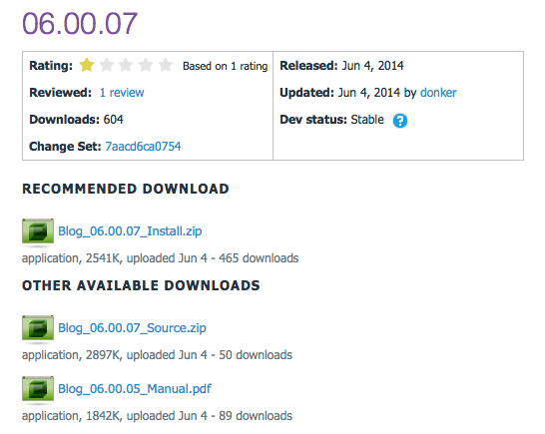
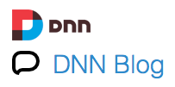
DNN Blog
v06.00.07 Released
Prod: 06/04/14

Slide 28
Release Notes
v06.00.07
Enhancement: Option to show management panel on child modules
Fix: Changed SPROC and code to ensure the right people are notified of pending comments. (CP-24018)
Fix: Fix to have notification actions authentication assume the right module id so these will work from the messaging center (CP-24019)
Fix: Fix to issue in categories in a post that will not save when no categories and no tags selected

Slide 29
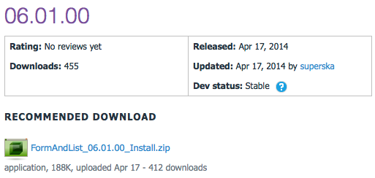
DNN Form and List
v06.01.00 Released
Prod: 04/17/14

Slide 30
Release Notes
v06.01.00
Fix for DNN 7.2.2
Allowed for custom datatypes.config (to be placed in Portals/_default/UserDefinedTable).
datatypes.config in the DesktopModules/UserDefinedTable will remain to be overwriten on installation of a new version. However, if you copy it to the folder mentioned above, your cusotmizations will not be overwriten on installation anymore.

Slide 31
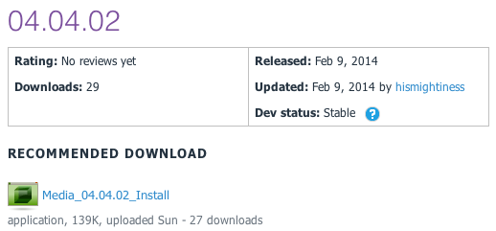
DNN Media
v04.04.02 Released
Prod: 02/09/14

Slide 32
Release Notes
v04.04.02 Release
This release has the follow new features and updates:
Tested for version 07.02.00 compatibility
Updated oEmbed to version 00.03.00
Added missing description below images
Fixed oEmbed SSL providers (can use https now)
Fixed CSS conflicts with fieldsets
Removed NewtonsoftJSON dependency
Fixed issue with sub-directories being used for local media
Fixed URL that is generated
System Requirements
DotNetNuke v07.02.00 or newer
.Net Framework v4.0 or newer
SQL Server 2008 or newer

Slide 33
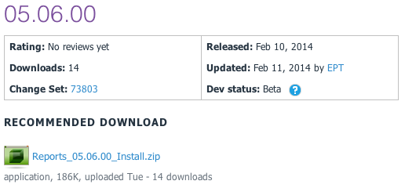
DNN Reports
v05.06.00 Released
Prod: 02/10/14

Slide 34
Release Notes
v05.06.00 Release
Release to make DNN Reports work for DNN 7.0.0 and up
BUG FIXES
Fixed xslt visualizer xsl file retrieval
Fixed HTML visualizer html file retrieval
ENHANCEMENTS
Made the dataprovider scripts SQL Azure compliant

Slide 35
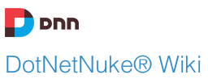
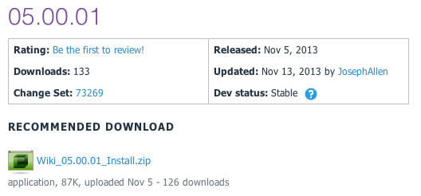
DNN Wiki
v05.00.01 Released
Prod: 11/05/13

Slide 36
Release Notes
Enhancements:
Journal Integration
Added "Delete Confirmation"
"Add Page" button to "All Pages View"
Big Fixes
Pressing Enter on Wiki Search Page Displays Search Results
RSS Feeds display correctly

Slide 37
CADUG Updates
Website & Social Media Websites

Slide 38
CADUG Website Hosting
The Chicago Area DotNetNuke Website Hosting is provided by:
Be sure to stop by and check out our sponsors for the best in DotNetNuke hosting
Sprocket Websites uses and recommends PowerDNN to its customers
Tony Valenti, CEO of PowerDNN

Slide 39
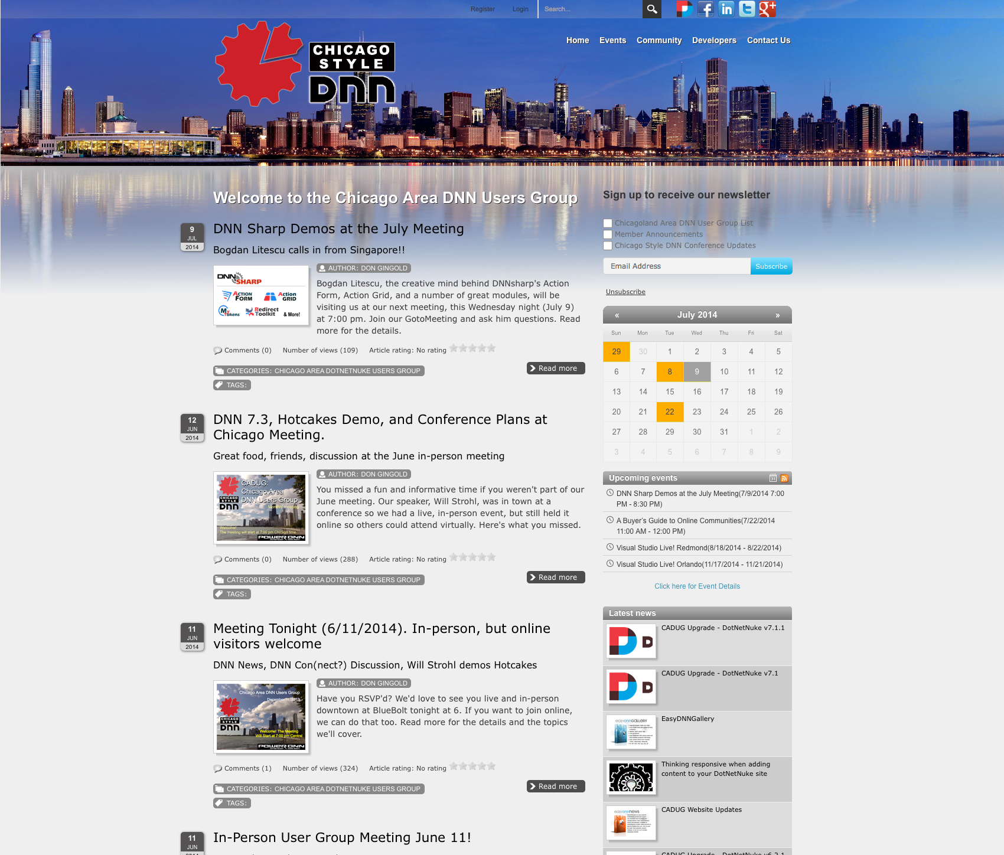
CADUG Website

Slide 40
Want to contribute to the Chicago Area DotNetNuke Website?
Ask Me How…

Slide 41
Wrap Up / Q&A
Important Links
Thank You
ChicagoDNN.org
meetup.com/ChicagoDNN
twitter.com/ChicagoDNN
DotNetNuke.com
store.DotNetNuke.com
PowerDNN.com
James Nagy
Sprocket Websites, Inc.
Jim@SprocketWebsites.com
www.SprocketWebsites.com
@SprocketWebsite
630.344.9320

